Slide 1
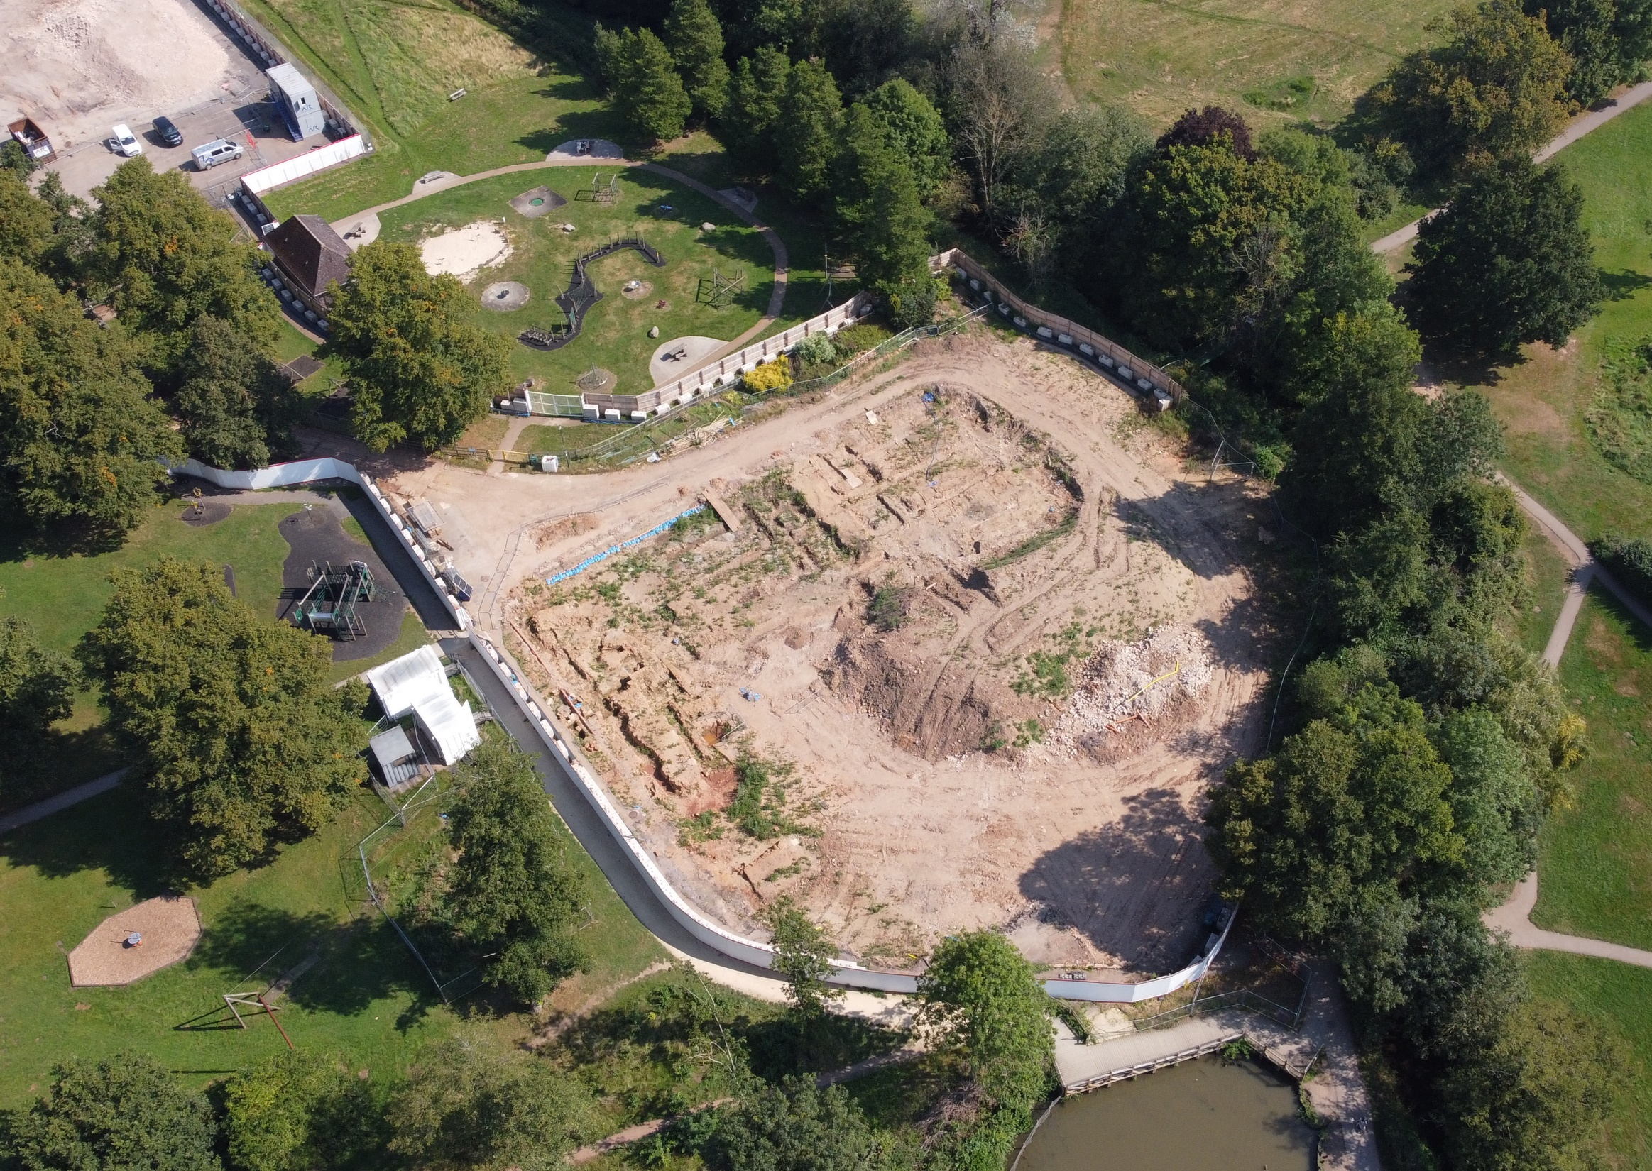
Abbey Fields Swimming Pools
Media Briefing
Wednesday 7th February 2024
Castle Farm Leisure Centre

Slide 2
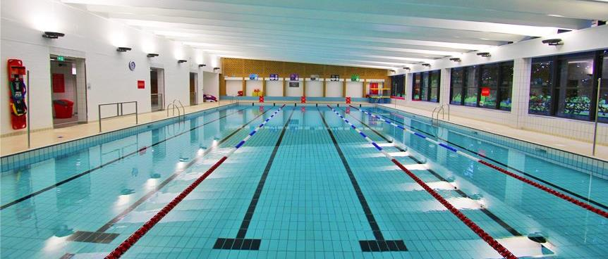
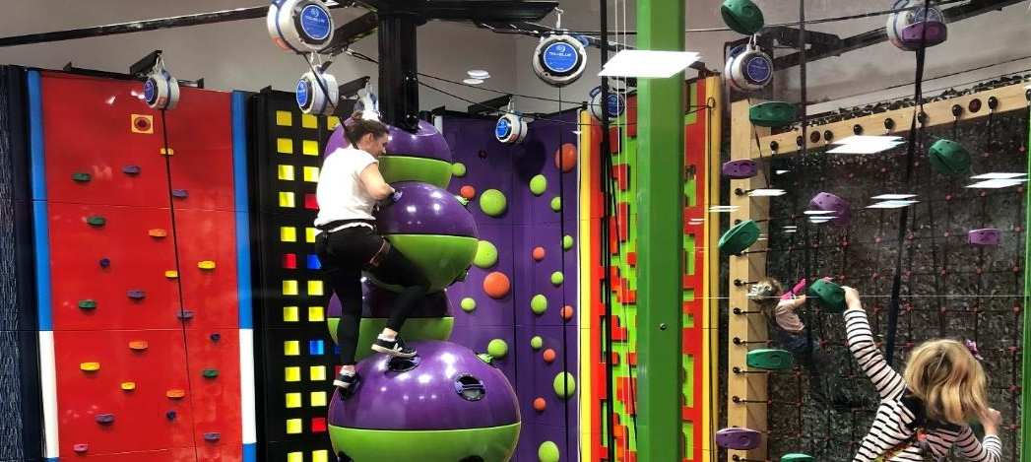
Leisure Development Programme
Abbey Fields is the latest facility in the WDC Leisure Development Programme
First two facilities were -
St Nicholas Park Leisure Centre
Newbold Comyn Leisure Centre
Both Sport England National Examples of Best Practice

Slide 3
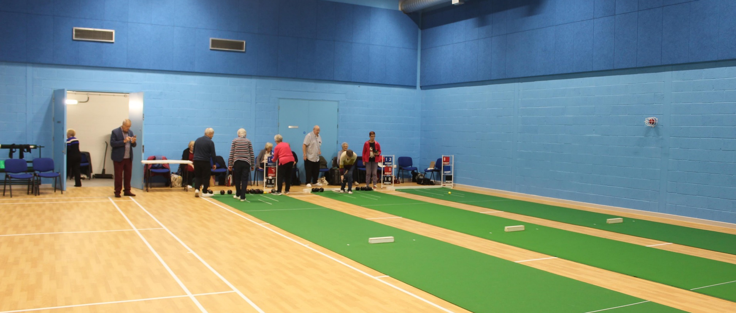
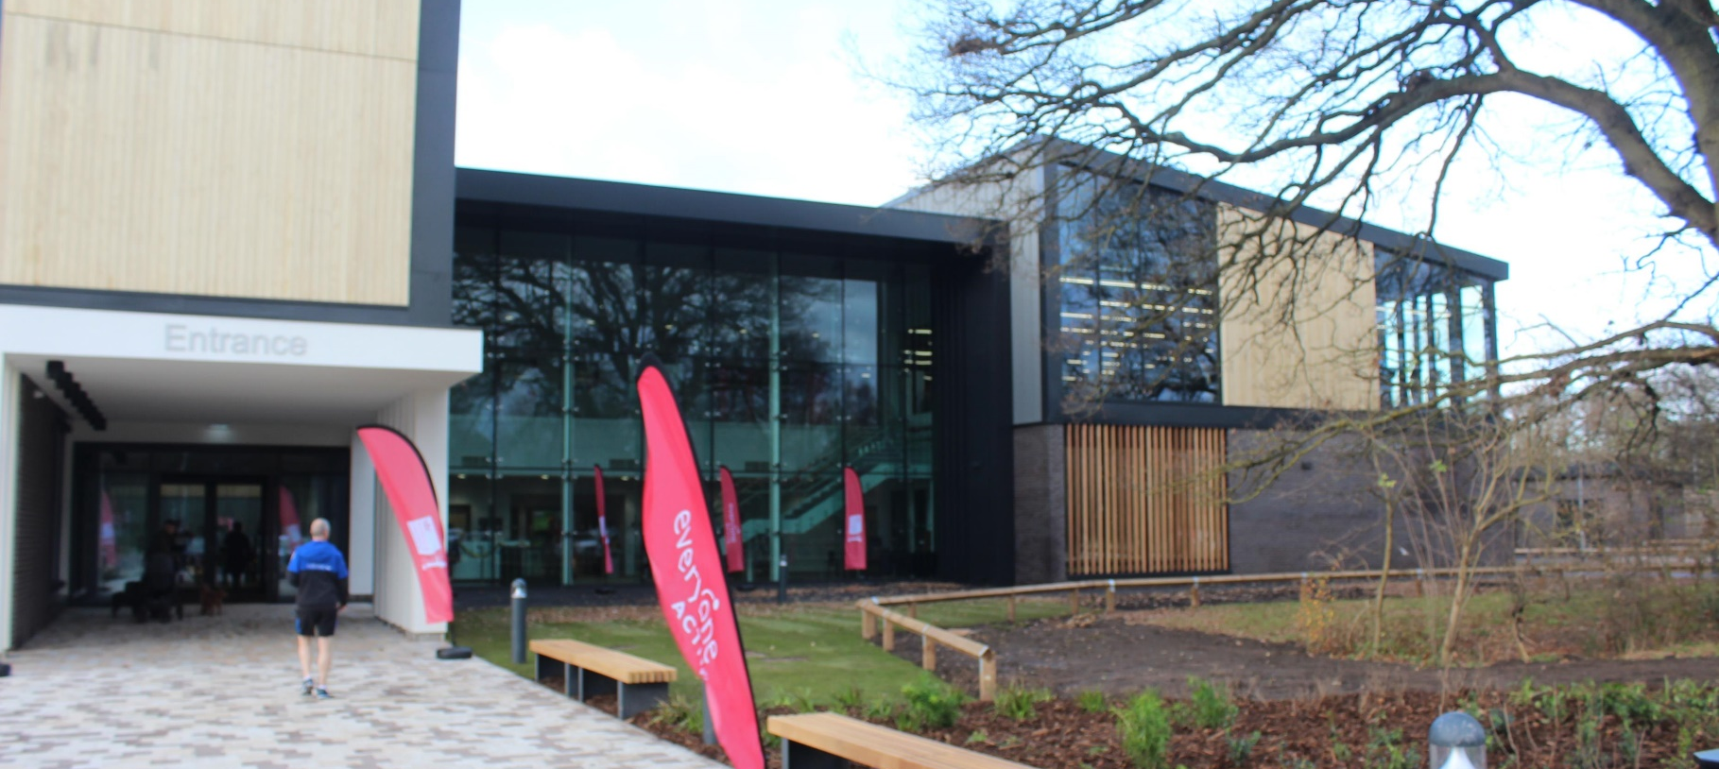
Leisure Development Programme
The next two facilities were –
Whitnash Civic Centre and Library
Castle Farm Leisure Centre with the Kenilworth Scout and Guide Centre
Future facilities will include -
Community Stadium
New athletics facility
The Myton Path
New Artificial Turf Pitch at Newbold
Multi-Use Games Areas

Slide 4
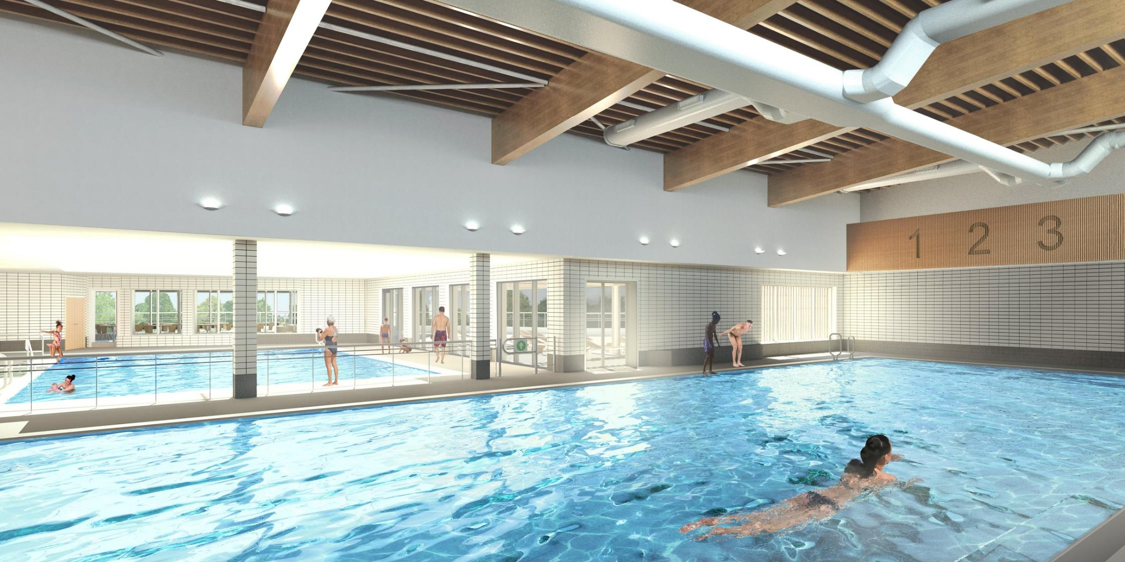
Abbey Fields Swimming Pools
Update on the design, planning, cost and timeline of the pools’ construction

Slide 5
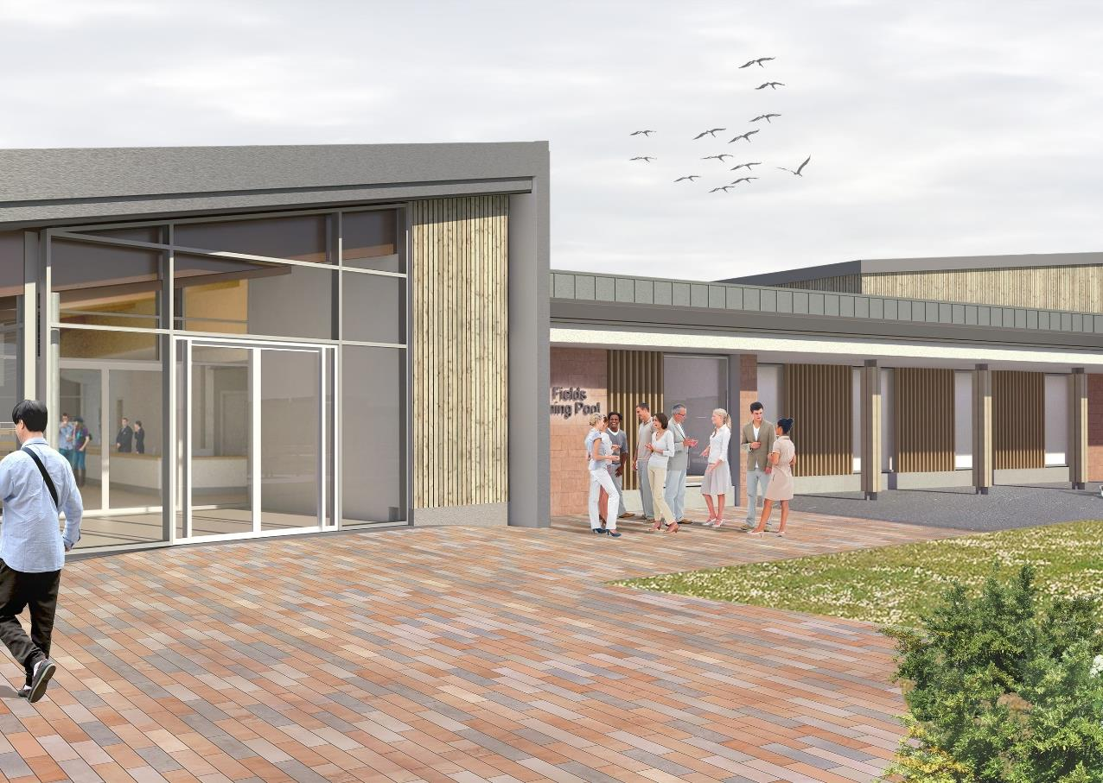
Update on the design
The Project Team have carried out the following tasks to deliver the pools and protect the medieval remains -

Slide 6
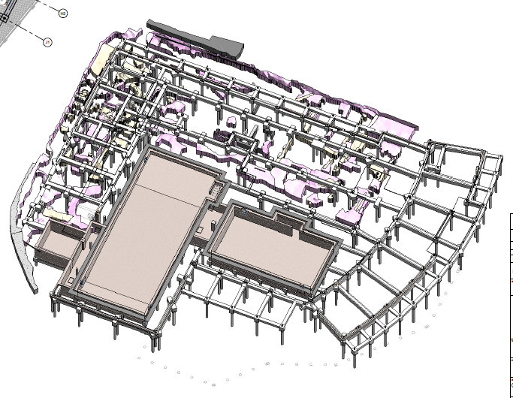
Redesign to raise the foundations
Changed the design to raise the foundations by 50cms
Moved from ground-bearing slab to suspended slab construction
Agreed the location of every pile with Historic England

Slide 7
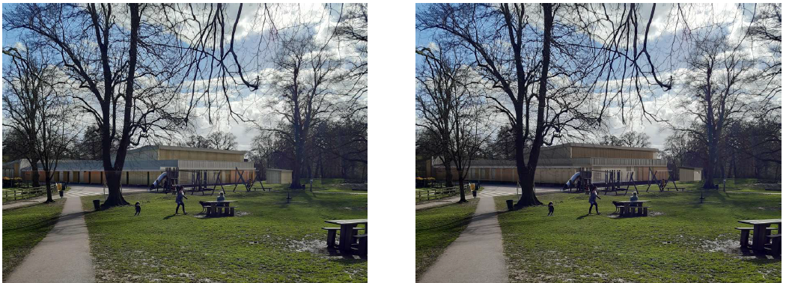
Redesign structural detail within the building
Redesigned some structural detail such as roof voids to only raise the ridge height of the building by 35cms.

Slide 8
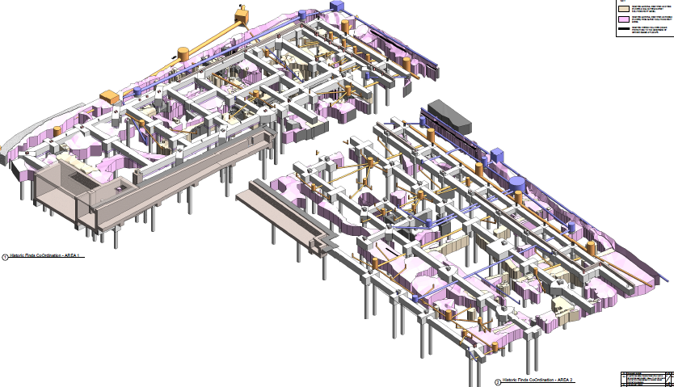
Redesign the drainage system
A new design to the drainage system and utility services to avoid any significant clashes with medieval remains

Slide 9
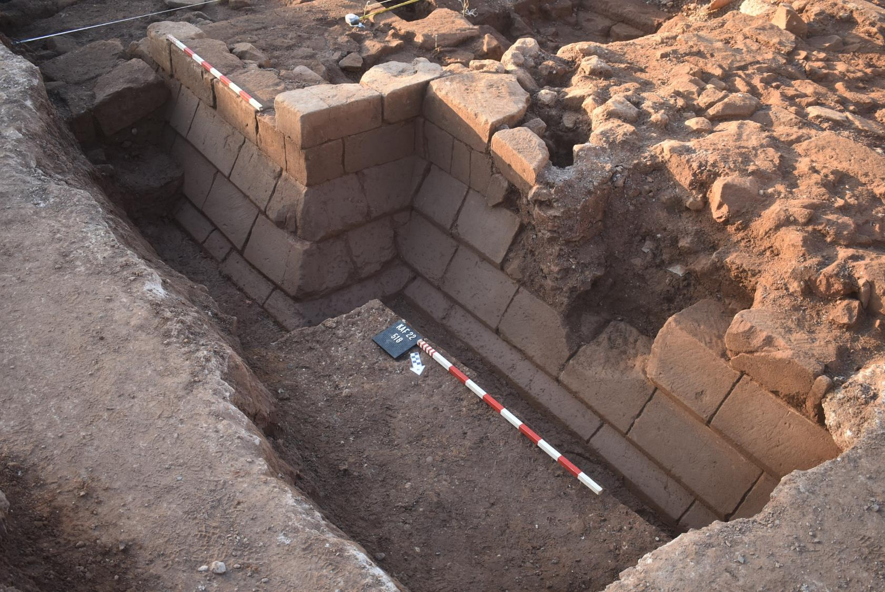
How else did we protect the medieval remains?
Covered the remains in protective material.
Carefully packed them with native soil, filling all voids.
Placed a ‘piling mat’ of stronger material on top.
Suspended slab foundations will go on top of this.
Virtual reality record of remains
Headsets will be available
Can be accessed by mobile phone
Findings will be written up in academic records

Slide 10
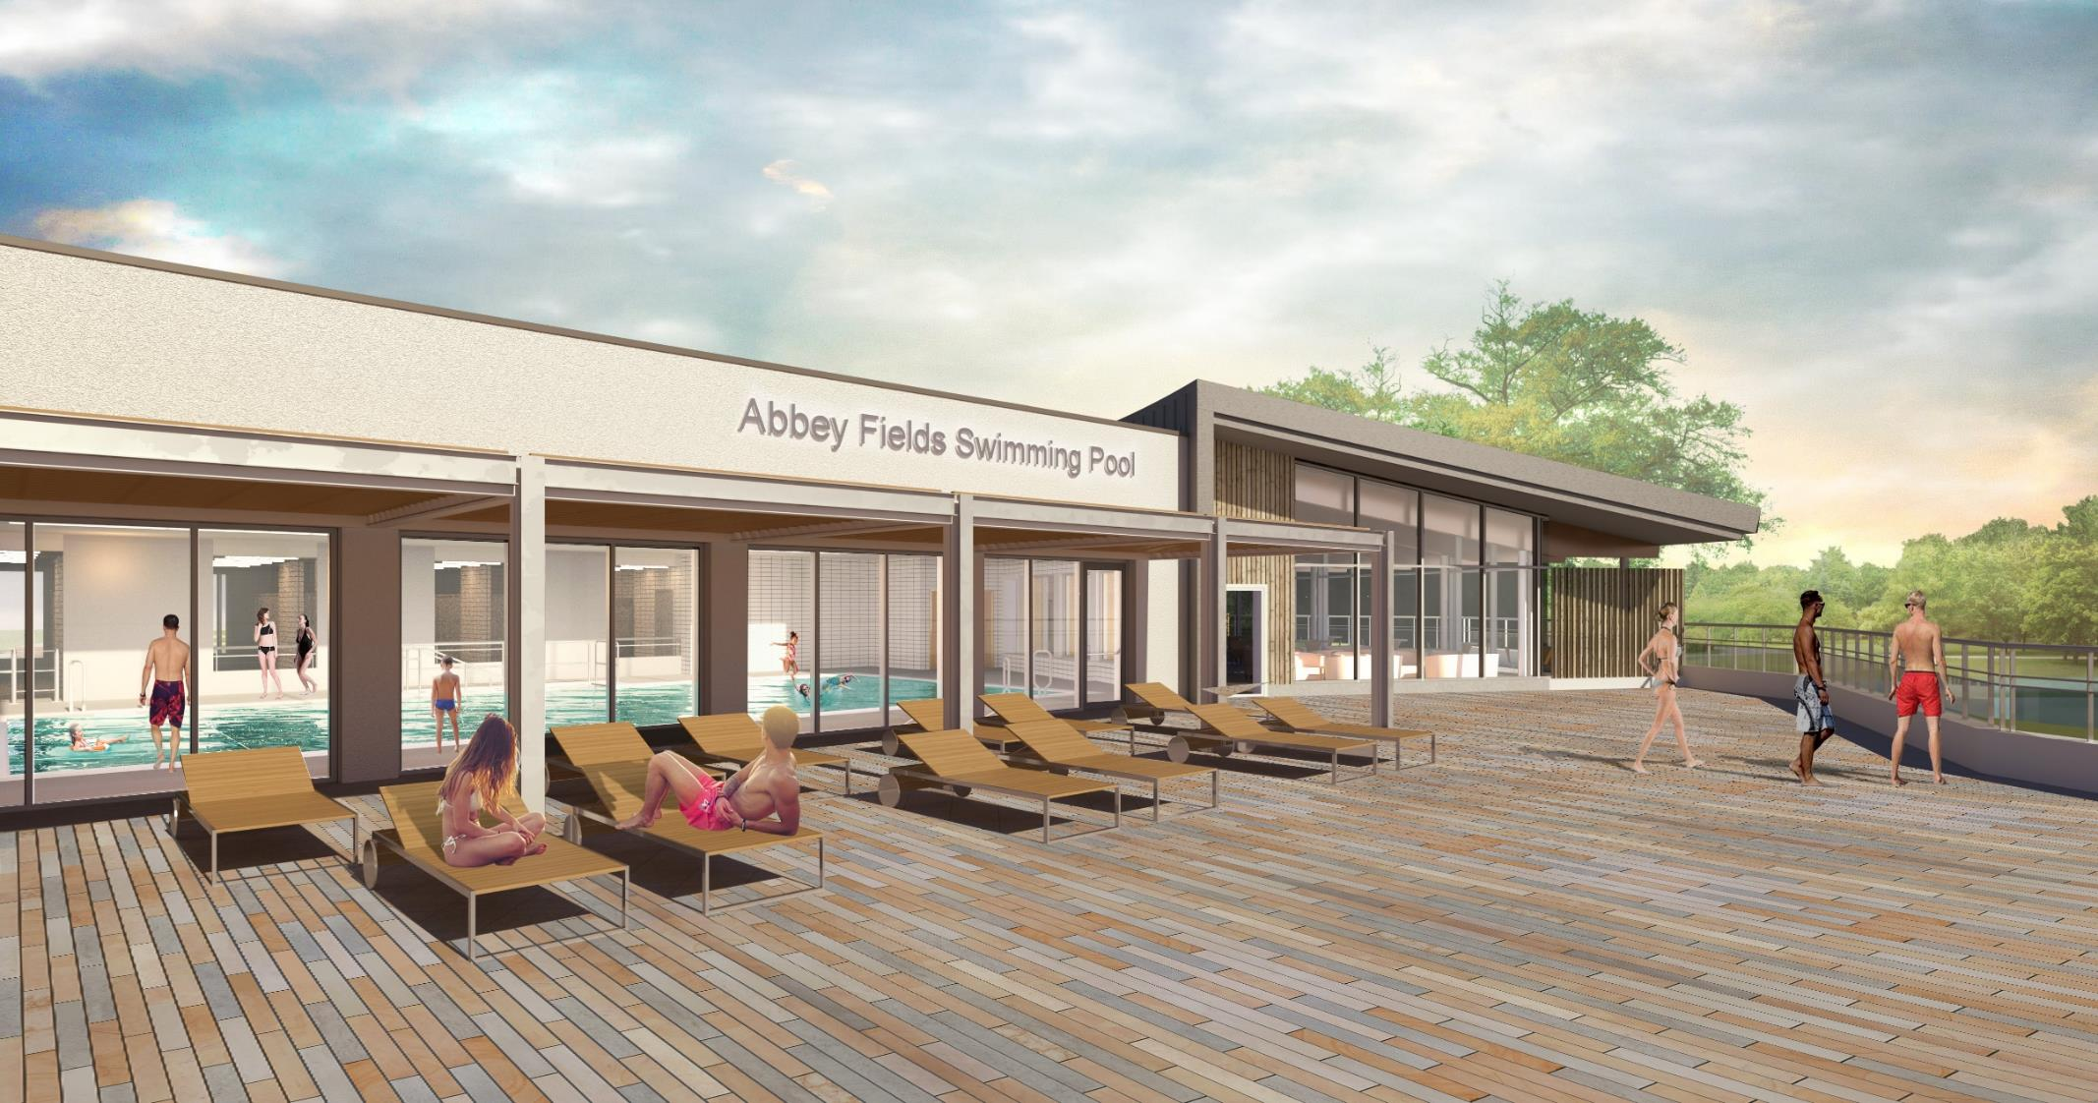
Update on planning
Section 73 application to raise the base of the building 500mm and the ridge height 350mm was approved in December
Dealing with Conditions now
Project has full planning permission (with Conditions)

Slide 11
Update on cost
The returns from sub-contractors were higher than anticipated. This was because –
The design changes were more complex than anticipated in July
Local construction costs are rising fast (as seen in other projects)
Initial price was unaffordable
The Council has worked closely with Mace and Kier to resolve this issue
Kier has offered a substantial reduction in cost to enable to work to continue
The Council has decided to drop the duck feeding platform and the refurbishment of the tennis courts from the works at present
The tennis courts will be the first item reinstated to the project if the contingency is preserved
If not, the work will be funded from elsewhere as it is a planning requirement

Slide 12
Conclusions on cost
The Council has agreed a price with Kier of £22,000,000 exactly
This enables the Council to remain within its agreed overall cost ceiling for the project whilst protecting the agreed contingencies
The Council has agreed for Kier to proceed with the works
The project will be very closely monitored for costs throughout construction

Slide 13
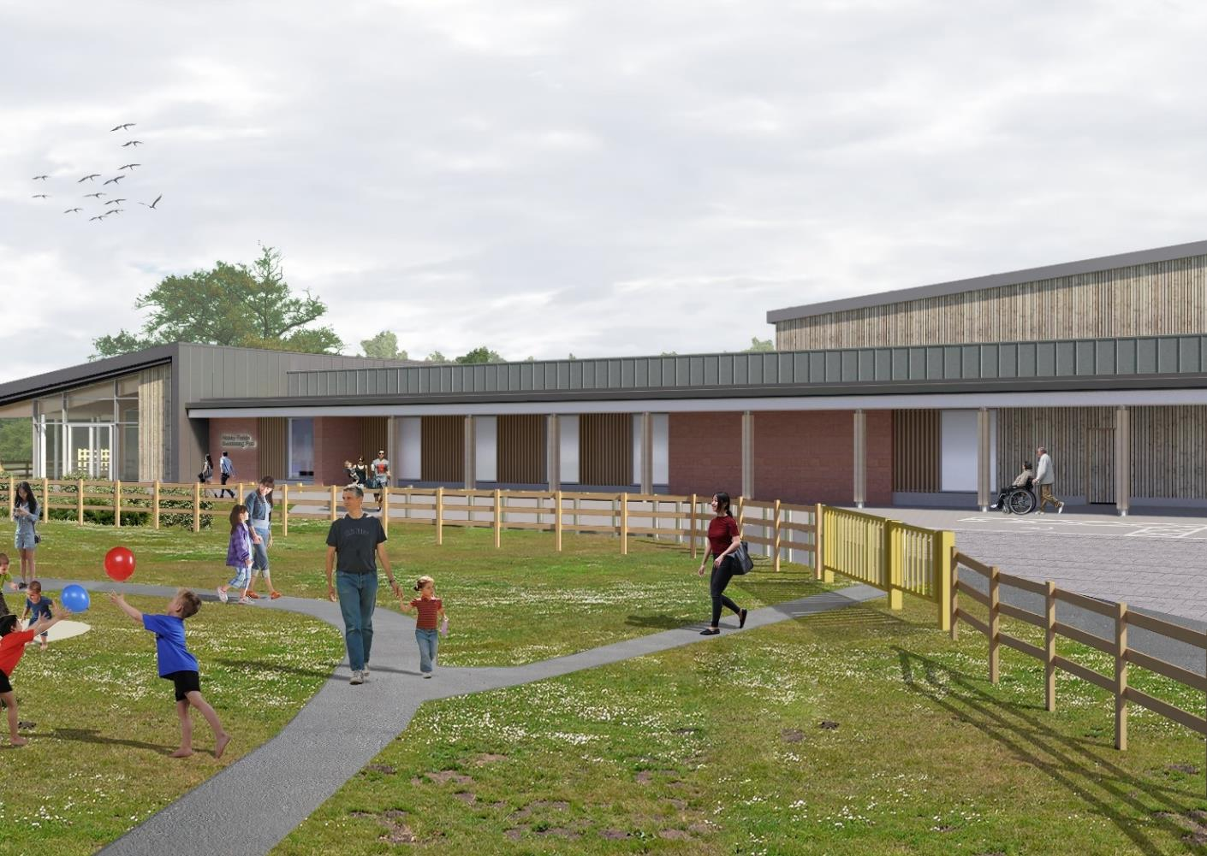
Update on programme
Both the Council and Kier are very keen to get construction underway as soon as possible
Enabling works to set up the site will begin in February
Construction will begin in March
The programme has had to be extended due to the complexity of the suspended slab foundations
In November it was reported that the programme was predicted to be 114 weeks
Further analysis means the agreed programme is now 121 weeks
This will lead to completion in the summer of 2026

Slide 14
How important is the swimming pools project?
The Sport England Facilities Planning Model identifies that both pools are required to provide enough swimming water for Kenilworth and surrounding areas
Kenilworth has had one or more pools for over 120 years
It is a facility for the whole District – particularly for swimmers with a disability and in summer weather
It is a key part of the Council’s Leisure Development Programme, providing facilities (with Castle Farm) to rival Newbold Comyn and St Nicholas Park Leisure Centres
It is very important indeed!

Slide 15
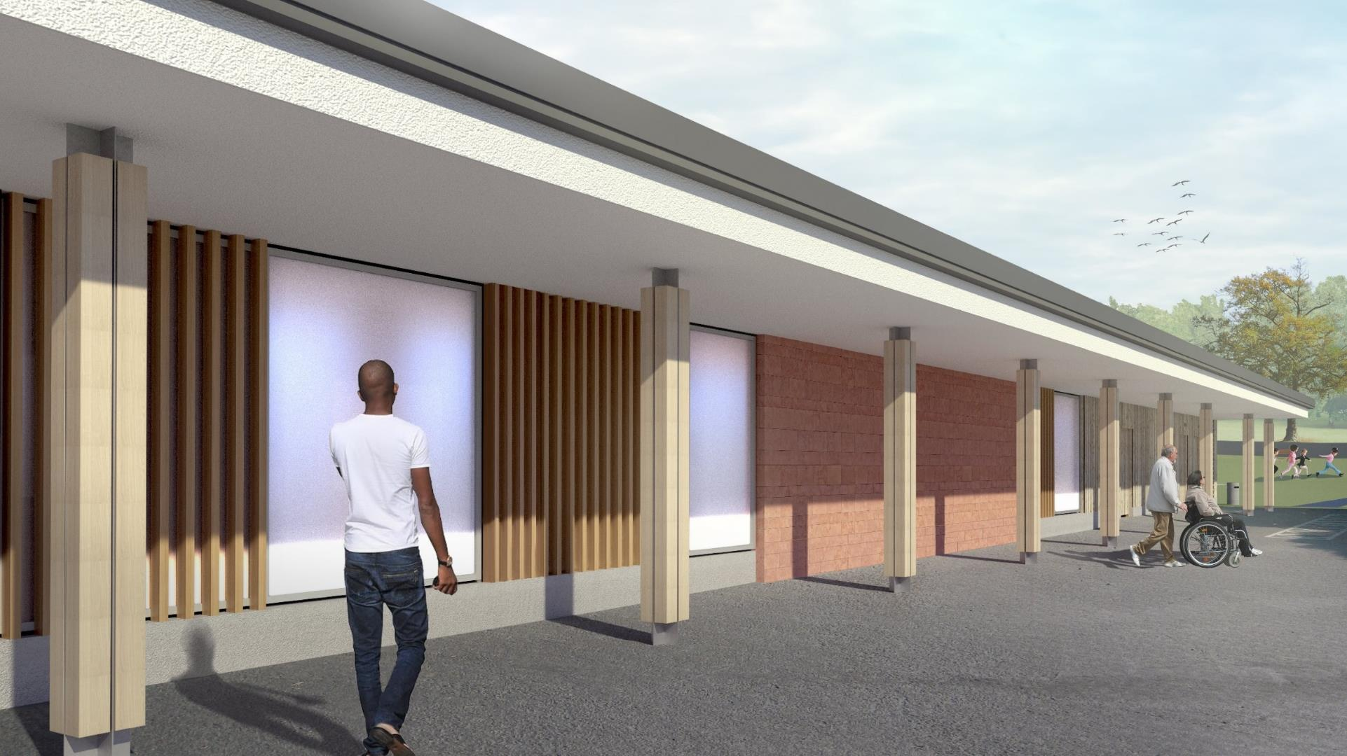
Abbey Fields Swimming Pool - Design
All other details of the design remain the same as the agreed Planning Permission.
As a reminder, the project will provide…

Slide 16
Main Swimming Pool
25m long
5 lanes
Wider surrounds
Spectator seating
Door to sun terrace
Changing Place facility
Accessible changing spaces / School change / village change

Slide 17
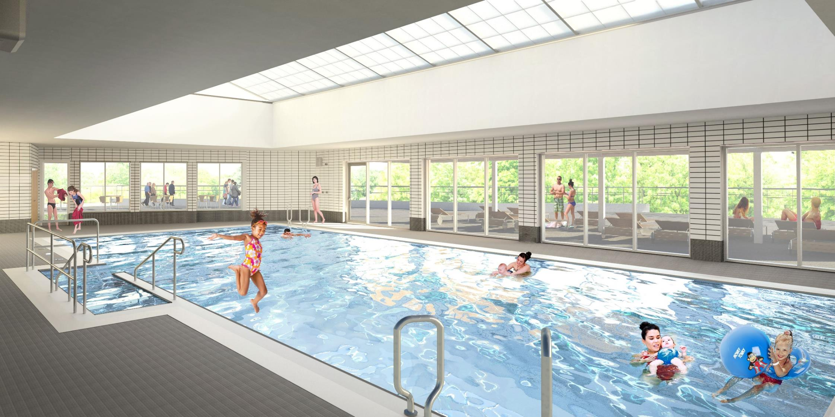
Family Swimming Pool
15m long
Movable floor
Bi-fold wall to sun terrace
Accessible hoist
Easy access steps
Water play features
Viewing from café seating
Natural light from above

Slide 18
Sun terrace
Sun terrace
Fully enclosed for safety
Bi-fold wall to family pool
Door to main pool
Views of the Lake & Abbey Fields

Slide 19
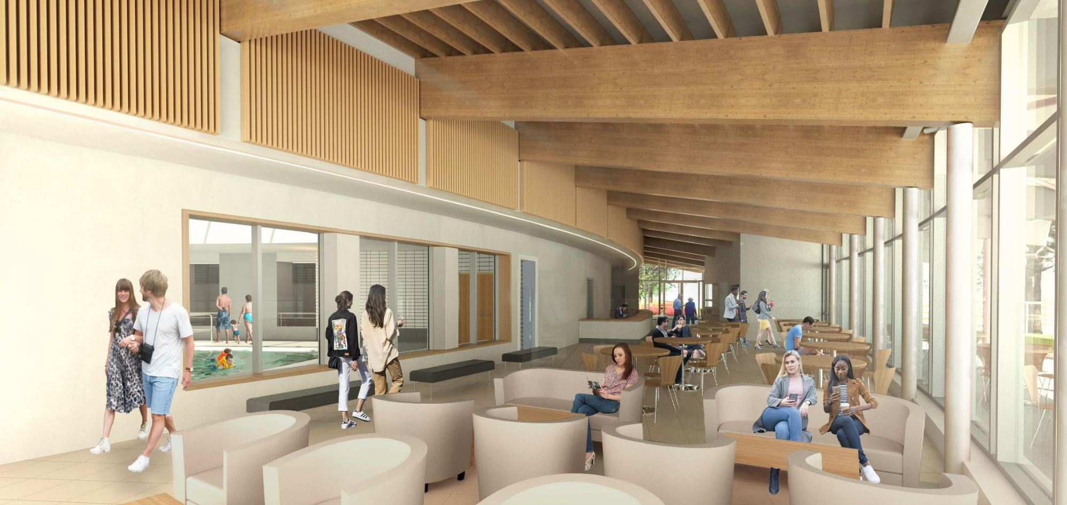
Café and Reception
Reception area
Servery
Café seating – open to all
Casual seating
Brook terrace
Accessible toilets
Views to Family Pool & Finham Brook
External toilets

Slide 20
Any Questions?

