Slide 1
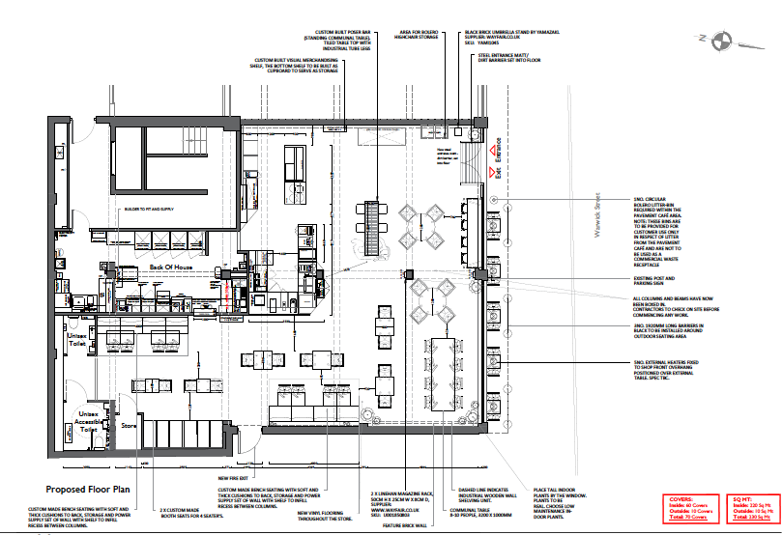
Outside perimeter
Our outside seating of 10 covers extends to, on the pavement area.
External, pavement seating for 5 tables with up to 10 covers

