Slide 1
bar zero
Who are we?
Village action group to address climate change and biodiversity
Launched September 2019
Serving the villages of Barford Wasperton and Sherbourne
Core committee of Mary Peirson, Kirsty Healey, Liz Harrison-Hall, Ellie Lees and Sue Dunnett

Slide 2
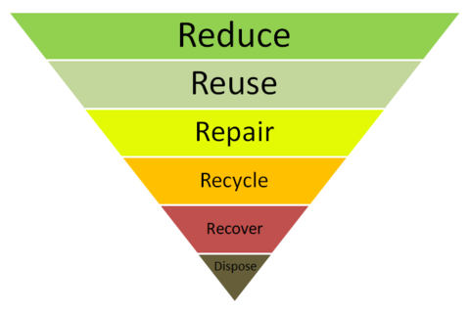
bar zero
Guiding principles
Everyone has a part to play tackling climate change
Helping individuals make a difference
Mix of supportive advice and community initiatives
Appeal to the individual’s best interests not just the planet
Notes:
Guardian Six key lifestyle changes individuals can make
Eat a largely plant-based diet, with healthy portions and no waste
Buy no more than three new items of clothing per year
Keep electrical products for at least seven years
Take no more than one short haul flight every three years and one long haul flight every eight years
Get rid of personal motor vehicles if you can – and if not keep hold of your existing vehicle for longer
Make at least one life shift to nudge the system, like moving to a green energy, insulating your home or changing pension supplier

Slide 3
Repair Café

Slide 4
bar zero
Reducing landfill
Local collection of pill blister packets, toothbrushes, toothpaste tubes, make up, stamps, corks which are then taken to recycling sites in town.
Encouraging re-use and re-purposing.
Using Barford Buy and Sell to re-home items within the community
Recycling of soft plastics at supermarkets

Slide 5
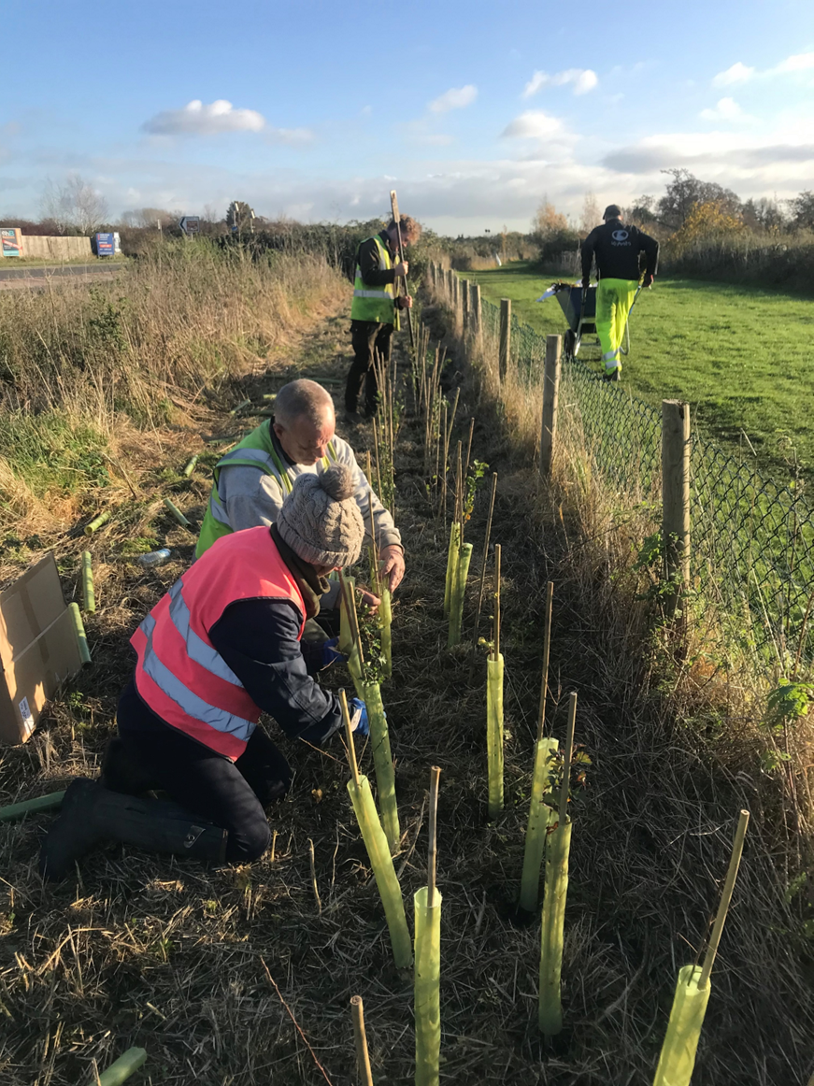
bar zero
Community hedge
Veg and herb planter

Slide 6
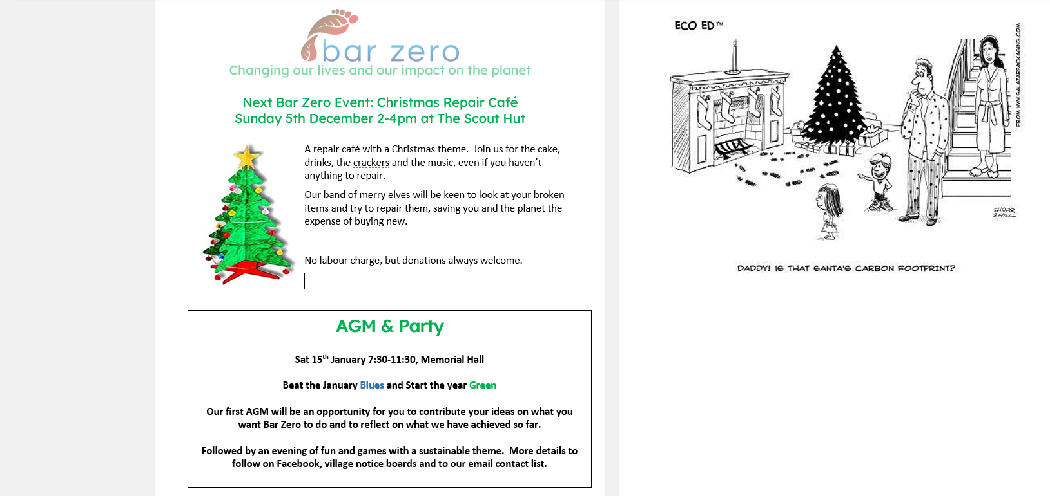
bar zero
Monthly article in Village Voices
Blank slide text in 28 point calibri

Slide 7
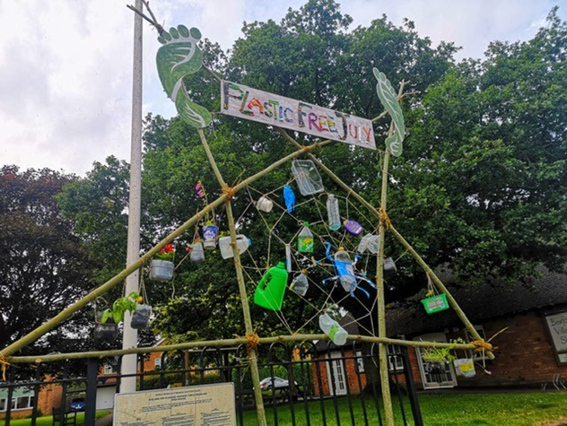
bar zero
Campaigns
Plastic Free July 21
Green Week March 21
Eek-oh Halloween clothes swap

Slide 8
bar zero
What next?
Wildflowers
Borrowing Scheme
Help with home efficiency
Working with our JPC
Working with our school
Programme of evening talks
Plastics, plastics, plastics

Slide 9
bar zero
But what needs to happen?
We are just a local campaign group and can only make a limited difference
We cannot look to the government to act fast enough
Need local leadership WCC WDC Parish
Nudging people to make those lifestyle changes
Can we make Warwickshire Zero carbon?

