Slide 1
Working Together to Reach Net Zero
Steve Smith
Director, and lead for Climate Change
Notes:
Climate change must be delivered by all stakeholders working together.
This is to present some of the initiatives that Warwickshire is taking forward and plan, and
My hope is that it might trigger an idea or an action, or a closer working relationship with members of the County Council

Slide 2
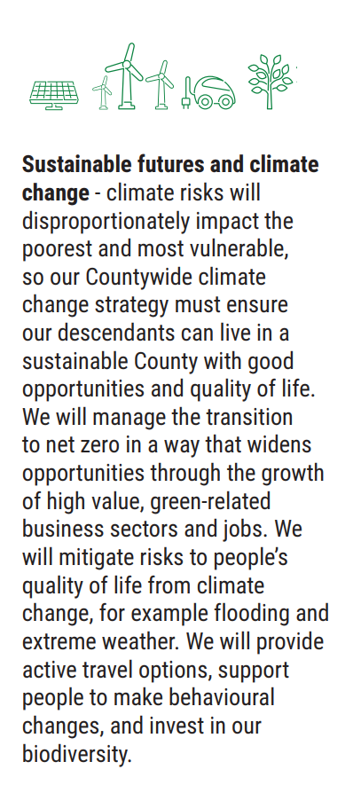
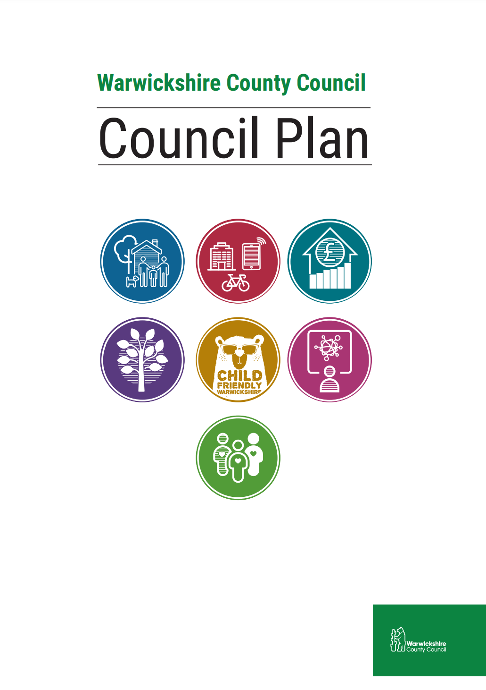
A Top Priority in our Council Plan: Sustainable Futures
We want to make Warwickshire the best it can be, sustainable now and for future generations
Climate crisis:
Reduce the Council’s carbon footprint to net zero by 2030
Work with all our partners and residents in Warwickshire to support the County to do the same no later than 2050
Biodiversity crisis:
Promoting Biodiversity and the safeguarding of natural species, habitats and areas in our County
Climate change adaptation:
Improving the resilience of our communities, businesses and services to the effects of climate change

Slide 3
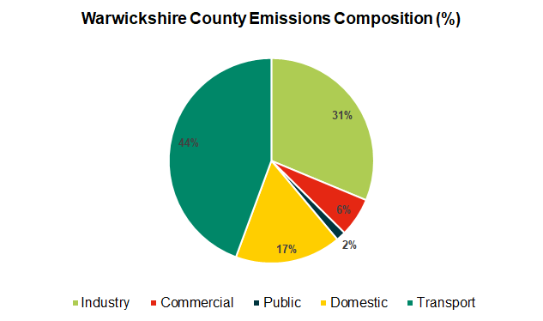
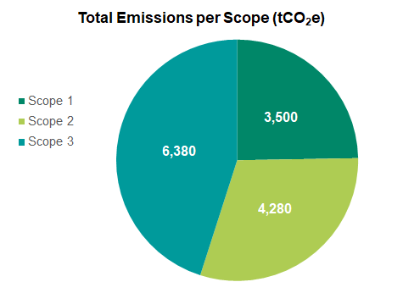
The race to Net Zero
2019/2020 Baseline: Warwickshire County Council
X 650
Public Sector: 2% direct emissions
Able to influence 31% County emissions
(LGA figures)
Warwickshire: 5,113 ktCO₂e
Notes:
The challenge to achieve a net zero Warwickshire is considerable.
Emissions from Warwcks are
As public sector bodies we only account for a small proportion of these emissions
But we can influence 31% of these emissions so have a huge part to play.
This just underlines the need to be working between us in the public sector
National policy, intervention and funding has a big part to play as do we at the local level
Those that work and live in Warwickshire
And those campaigning and working for change

Slide 4
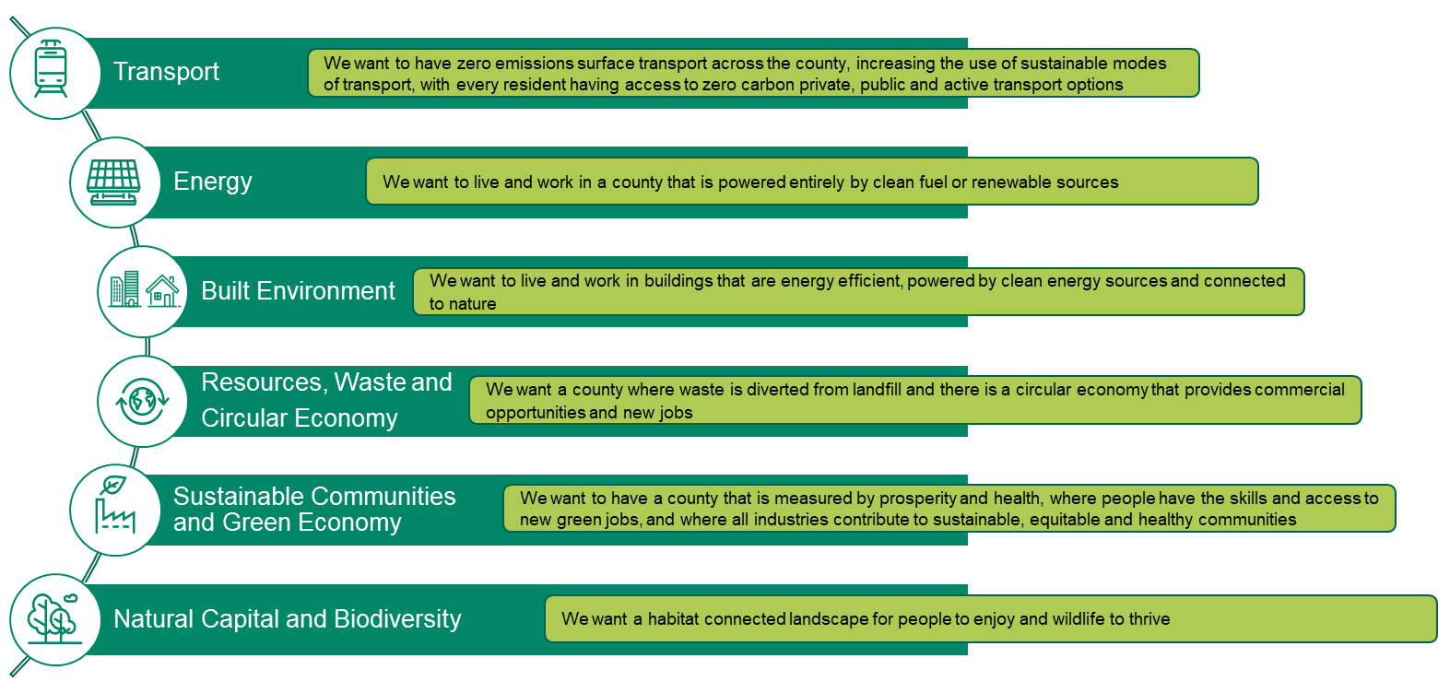
A Future Warwickshire - What do we want to see

Slide 5
Sustainable Futures Strategy: Key dates
Date | Action
13 October | Cabinet approved draft strategy
Mid November 2022 – mid January 2023 | Online engagement survey open to all
Until February 2023 | Focused panels
February/March 2023 | Engagement results available
Spring 2023 | Full adoption of the strategy by Cabinet
Survey will be available at: www.ask.warwickshire.gov.uk

Slide 6
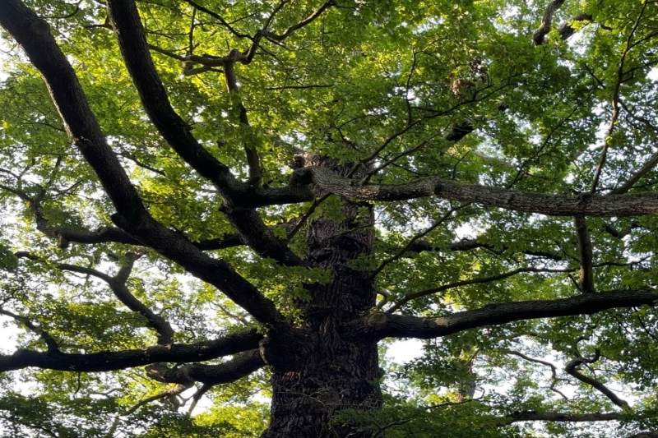
Biodiversity
Making our region a greener, happier and healthier place to live
The rural tree planting scheme: plant one tree for every resident
Working closely with District and Borough colleagues
To be recorded on the West Midlands Virtual Forest: https://www.wmvirtualforest.co.uk/
Platform is designed to record ALL new trees planted in the region
Implemented the first Local Government Biodiversity Net Gain in the UK
Requires developers to deliver a wider range of environmental benefits over and above the full environmental impact of the proposed development
Further developments in the pipeline regarding offsetting of emissions
Notes:
Delivering on our objectives on biodiversity is not only an environmental matter but also one that improves health and wellbeing and is fun to get involved in.

Slide 7
Green Shoots Community Fund: Phase 1
Communitybenefits
69
applications
funded, worth £625k
Carbon reductions
Climate Adaptation
Environmental benefits
Biodiversity projects - close to 2,800 trees planted and 1,600 hedges
Installation of renewable energy technology, e.g. solar panels and heat pumps on community venues;
Transport schemes that enable and promote active travel such as cycling and walking
£625k
Funded

Slide 8
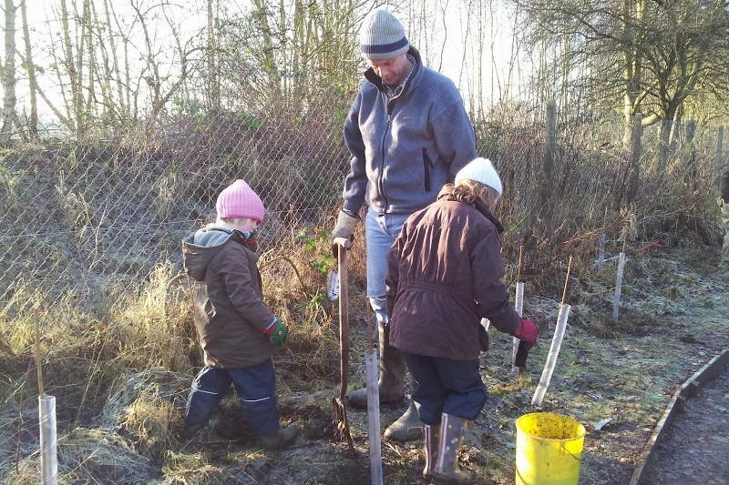
Green Shoots: Biodiversity and Community
The Children’s Forest at Leasowe Farm
Managed by Achieving Results in Communities (ARC)
Planting of 2,600 trees on 4 acres of land near Radford Semele
Expect to extract an average of 67,700kg of CO2 from the atmosphere per annum
On track to engage at least 250 children in the planting and maintenance process

Slide 9
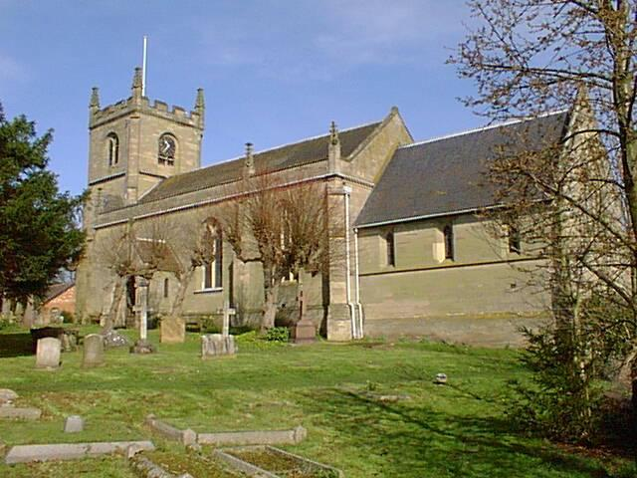
Green Shoots: Energy Efficiency
All Saints’ Church, Leek Wootton
Replacement of 100 year old heating system (cast iron pipework and electric boiler)
Fit new energy efficient infra-red panels
New heating panels also fitted to the vestry, kitchen, toilet and meeting room
Pew heaters upgraded
Notes:
Priory Park

Slide 10
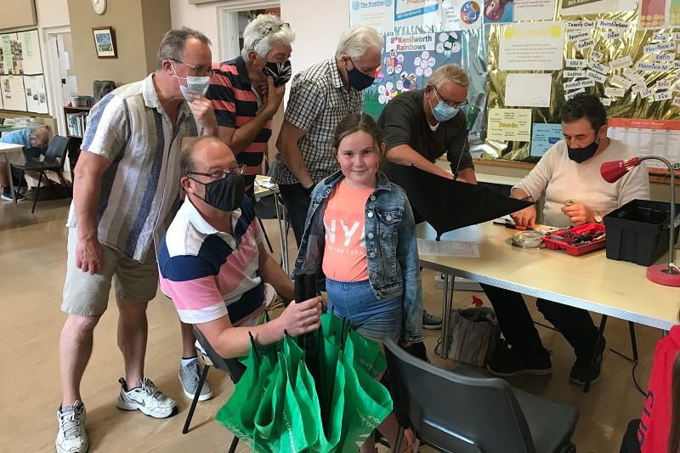
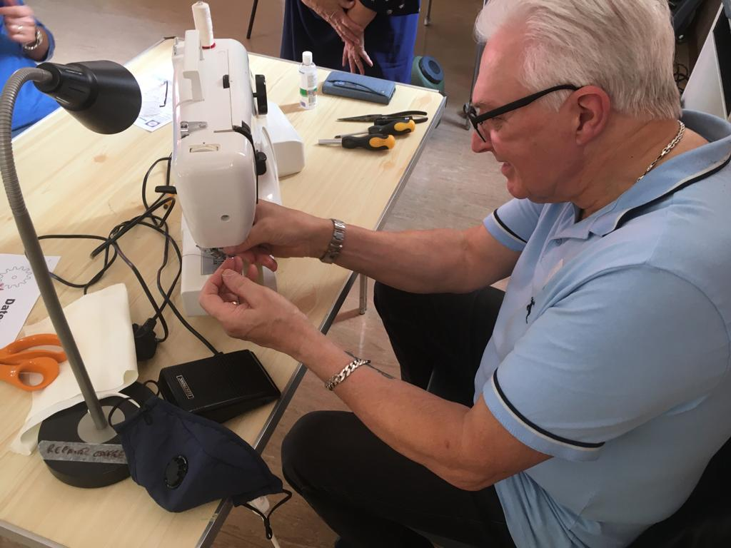
Green Shoots: Waste Reduction
Not-for-profit community event, held monthly
Reduce the amount of waste sent to landfill
Raise awareness of environmental issues by creating a culture of repair, rather than discard and replace
Helps with cost of living crisis
Joins other Repair Cafes in Warwickshire, including the Sydni Centre in Leamington

Slide 11
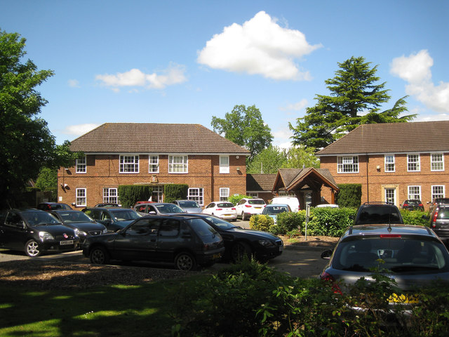
Green Shoots: Green Transport
Installation of two twin-head electric vehicle charging points
To support their existing fleet of electric vehicles, which include an adapted community transport vehicle
For use by staff, visitors and the wider community.
Notes:
Nuneaton Community of Christ Church

Slide 12
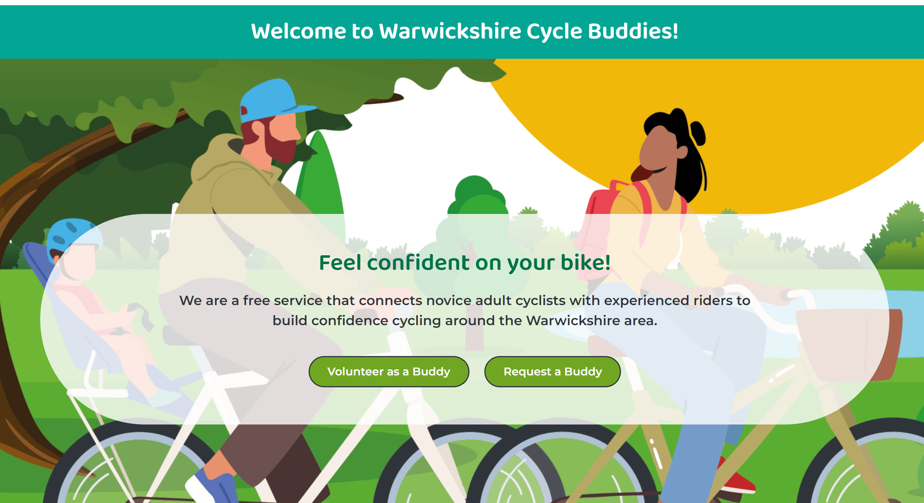
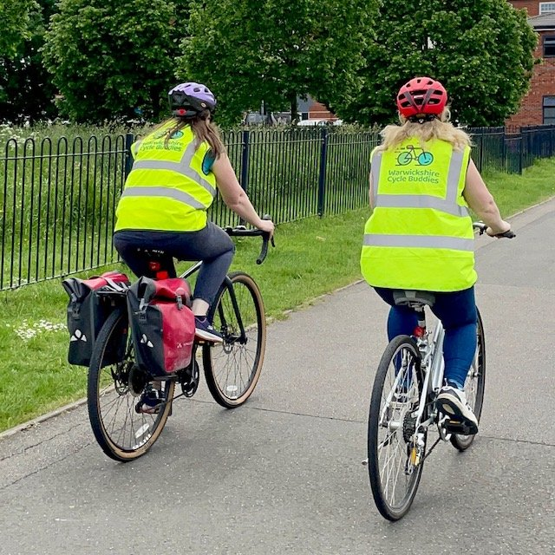
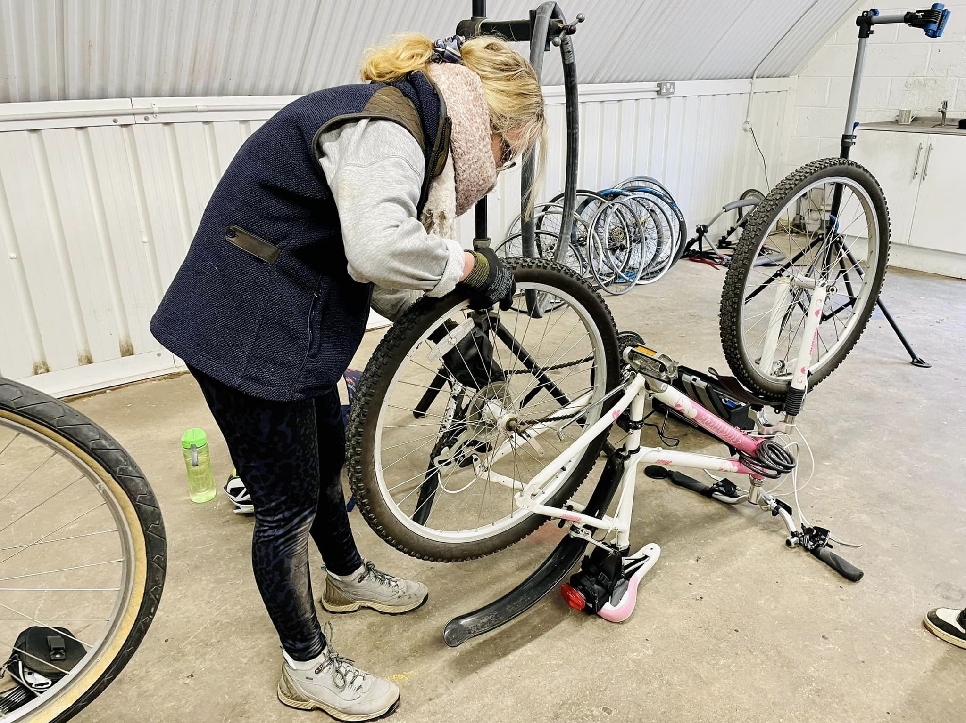
Green Shoots: Active Travel
Free service connecting novice adult cyclists with experienced riders to build confidence
Helps with techniques, route planning and basic bike maintenance
https://warwickshirecyclebuddies.co.uk
Notes:
Nuneaton Community of Christ Church

Slide 13
Green Shoots Community Fund: Phase 2
Same principle aims
Closely aligned to the Council’s refreshed Council Plan
Targeted to address unequal allocations in phase 1 and reducing social inequality
‘Not-for-profit' community and voluntary organisations in Warwickshire
Cost effective environmental benefits
Community benefits, accessible and free to access
Deliverable
A plan and resource to assess post-project benefits
Legacy value, potential for replication
110
Applications
received
£625k
Funded
104
applications
received, worth £1.7m
Grant offers from 22nd November
£350k budget
Notes:
https://www.warwickshire.gov.uk/news/article/2941/the-wcc-green-shoots-community-climate-change-fund-returns-with-more-funding-opportunities-for-climate-positive-projects
https://www.wcava.org.uk/news/2022/05/27/green-shoots-community-climate-change-funding-webinar

