Slide 1
Another GREAT presentation!

Slide 2
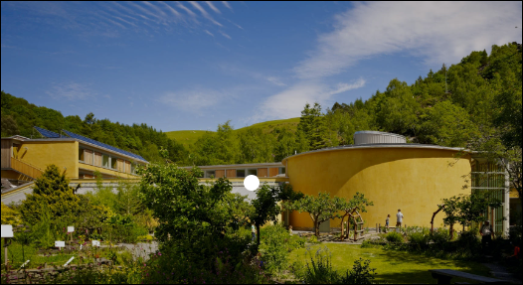
My inspiration for local action
December 2019

Slide 3
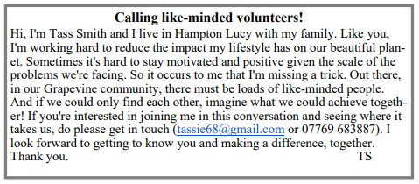
How did I go about it?
Bob Sherman
Dr Jacky Lawrence
December 2020

Slide 4
How did I go about it?
I suggested we should perhaps form a committee….
Okay, let’s forget that idea!

Slide 5
How did I go about it?
GREAT
Grapevine Environmental Action Team
Parishes of Hampton Lucy, Charlecote and Loxley
HelloGreatFuture@gmail.com
https://trello.com/b/Pz8kWzqd/hello-great-future

Slide 6
What kind of engagement have I had?
1 + 5 + 2 + 3 + 2 = 13
From Hampton Lucy & Loxley only so far
20 GREAT (Grapevine) articles, including:
Freecycling
Gardening for bees
Waste workout
Composting
COP26
Shopping local, reducing plastic
Repairs
Energy / water saving tips
Hedgehog Highways
GREAT has acted as an influencer in the community.
Some responses to newsletter articles
Folk looking to GREAT to kick-start initiatives

Slide 7
What have we achieved so far?
Hampton Lucy Parish Council
£50 donation for bird boxes
Plus they have just formally acknowledged
the Climate Emergency
500 saplings in
Hampton Lucy and Loxley
Started to create a Children’s Wild allotment
Risk assessment
Insurance
Fencing

Slide 8
What’s next?
Join up with the Charlecote village wildlife group
Book in regular Zoom meetings for 2023
Maybe lead on the Hampton Lucy wildflower planting (Parish Council idea)
Complete the Children’s wild allotment area, by the school
Start a community allotment
More Grapevine articles
Find someone less introverted than me to take the helm!
Create some hedgehog highways
Explore sharing ideas – skills, equipment
Encourage Loxley Parish Council to acknowledge the climate emergency
Help the Parish Council(s) to honour their Climate Emergency acknowledgements

