Slide 1
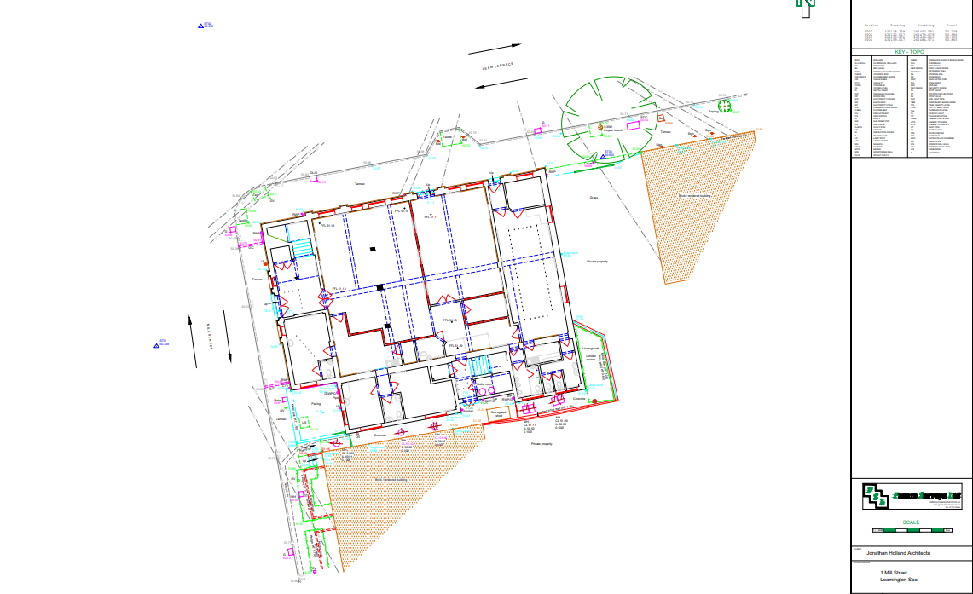
The Table position
The Tables will be placed against the north facing Mill Street wall (Leam Terrace).
The tables are 27”x31”x31” to ensure they are accessible to people of all physical abilities.
The Chairs are 17”x19”x32”

Slide 2
