Slide 1

Placemaking in
Leamington Spa
Chair
Ross Sleight Somo Global
Guy Collier Warwick District Council
Ellie Hirons Warwick District Council
Emma Harrabin Complex Development Projects

Slide 2
Placemaking in
Leamington Spa
Overview
Leamington Spa Town Centre Vision
Introduction to the Future High Streets Fund
Leamington Spa Creative Quarter
Creative Quarter Focus
Q & A

Slide 3
Leamington Spa Town Centre Vision
Challenges
Declining footfall
Growth of internet and “special forms of trading”
Growing population
Competition from out-of-centre shopping and other centres (Solihull, Birmingham, Banbury, Stratford, etc)
Vacancy rates
Economic disparities
GP Facilities
Growth of demand from students
Leamington as a visitor destination
Congestion
Connectivity
Air quality
Notes:
Declining footfall – 10% decline 2016-18 (in common with other town centres) – imbalance in footfall between N and S of river
Growth of internet and “SFT (all non-store retail sales made via the internet, mail order, stalls and markets, door-to-door and
telephone sale) – 16% now – 22% by 2036.
Growing population: 26% in Warwick District 2011 - 2029
Competition from out-of-centre shopping centres – R&LS identified 6,983 sq m in next 10 years
Growth of other centres (Solihull, Birmingham, Banbury, Stratford, etc) – Coventry has ambitious plans for retail growth in city centre
Vacancy rates – 11.3% compared to 9.8% nationally. Increase in vacancy within BID area
Economic disparities
GP facilities – GP practices all under pressure
Growth of demand from students – estimated that we need to find 120 bed spaces for next 3 years
Leamington as a visitor destination

Slide 4
Leamington Spa Town Centre Vision
Vision
“ build a welcoming town centre; that celebrates its cultural and economic present and looks forward to innovative future developments. A town centre where visitors and residents alike are offered a rich experience, whether working, shopping, eating and drinking, or enjoying the town’s cultural and social activities.”

Slide 5
Leamington Spa Town Centre Vision
Six Big Ideas
  A thriving town centre
  A hub of creativity
  A connected town centre
  Enhancing Old Town
  Revealing Leamington’s waterways
  Places to meet in the town centre

Slide 6

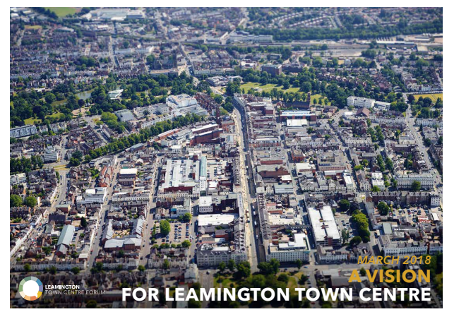
Leamington Spa Town Centre Vision

Slide 7
Introduction to the Future High Streets Fund
Objective of fund is to renew and reshape town centre/ high street in a way that improves experience, drives growth and ensures future sustainability.
The Fund aims to deliver structural transformation through capital investment in land, buildings and infrastructure.
Overarching
Objectives

Slide 8
Introduction to the Future High Streets Fund
  Investment in physical infrastructure
  Acquisition and assembly of land including to support new housing, workspaces and public realm
  Improvements to transport access, traffic flow and circulation in the area
  Supporting change of use including (where appropriate) housing delivery and densification
  Supporting adaptation of the high street in response to changing technology
Strategic
Objectives

Slide 9
Introduction to the Future High Streets Fund
Strategic case
Economic case
Commercial case
Financial case
Management case
Making
the case
Notes:
5 Step business model (HMT Green Book)
Strategic case: setting out the rationale for activity and the objectives of the proposal. It will be used to assess the extent to which proposals successfully meet the overall objectives of the fund.
Economic case: including an appraisal of a number of options and a robust assessment of the predicted costs/ benefits of the project. This is used to assess the overall value for money of projects.
Commercial case: setting out the delivery model including procurement and commercial arrangements that are needed to implement the project. This is used to assess whether the proposal can be effectively delivered and is commercially feasible.
Financial case: Including details on the costs of the project demonstrating that the preferred option can be delivered successfully within the funding available.
Management case: setting out the planning and practical arrangements for implementing the project, including any risks and monitoring and evaluation. It is used to assess if the proposal is practically deliverable.

Slide 10
Introduction to the Future High Streets Fund
Why Leamington?
What are we proposing?
Making
the case
Notes:
Why Leamington
We have challenges but things pretty good?
Identify market failure – grow on space for creatives and connectivity
Need to protect the town centre

Slide 11
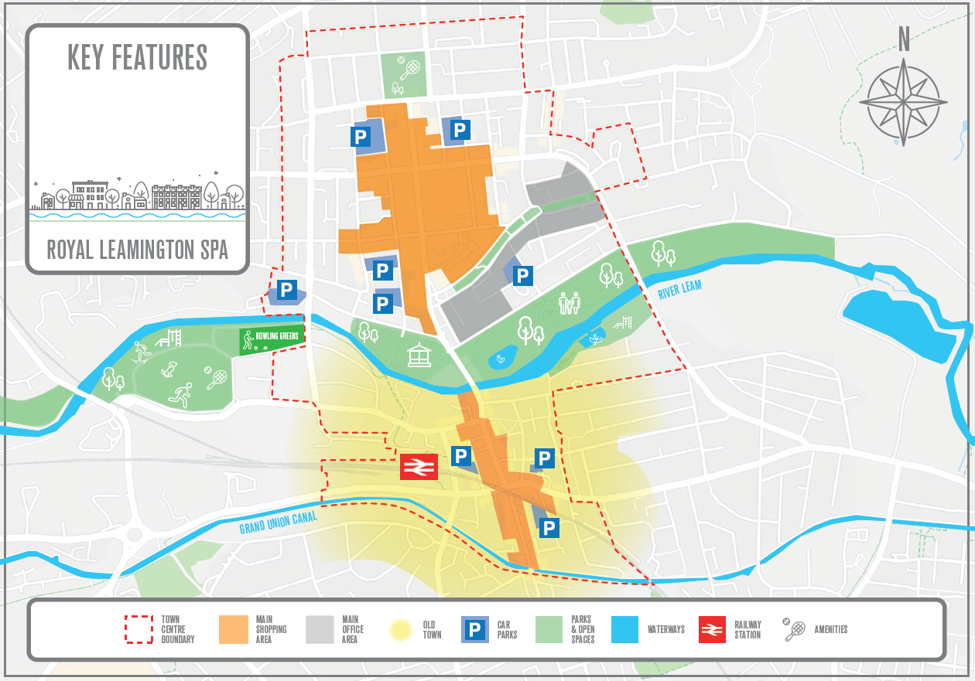
Introduction to the Future High Streets Fund
Making
the case
Notes:
Why Leamington
We have challenges but things pretty good?
Identify market failure – grow on space for creatives and connectivity
Need to protect the town centre

Slide 12
Introduction to the Future High Streets Fund
Making
the case
Notes:
Why Leamington
We have challenges but things pretty good?
Identify market failure – grow on space for creatives and connectivity
Need to protect the town centre

Slide 13
Introduction to the Future High Streets Fund
Why Leamington?
What are we proposing?
Next steps
Making
the case
Notes:
Why Leamington
We have challenges but things pretty good?
Identify market failure – grow on space for creatives and connectivity
Need to protect the town centre

Slide 14
Leamington Spa Creative Quarter
Ellie Hirons (Project Officer)
Notes:
Why Leamington
We have challenges but things pretty good?
Identify market failure – grow on space for creatives and connectivity
Need to protect the town centre

Slide 15
Leamington Spa Creative Quarter
What is a Creative Quarter?
Offers a creative environment with opportunities for physical and economical regeneration
Promote creative diversity
Benefits for community groups
Notes:
Why Leamington
We have challenges but things pretty good?
Identify market failure – grow on space for creatives and connectivity
Need to protect the town centre

Slide 16
Leamington Spa Creative Quarter
What are the benefits for Leamington?
Commercial growth
Build upon and reinforce the importance of Creative and Digital Industries
Create a vibrant and desirable destination for employers and visitors
Notes:
Why Leamington
We have challenges but things pretty good?
Identify market failure – grow on space for creatives and connectivity
Need to protect the town centre

Slide 17
Leamington Spa Creative Quarter
Where are we today?
Delivery Partner appointed
Intensive public consultation
Big Picture Document Approved
Phase 1 complete
Phase 2: Delivery!
Notes:
Why Leamington
We have challenges but things pretty good?
Identify market failure – grow on space for creatives and connectivity
Need to protect the town centre

Slide 18
Leamington Spa Creative Quarter
What are our next steps?
Sites within WDC ownership
CDP involvement
Notes:
Why Leamington
We have challenges but things pretty good?
Identify market failure – grow on space for creatives and connectivity
Need to protect the town centre

