Slide 1

Leper’s Hospital, Saltisford, Warwick
Feasibility Study
Phase 3 Outline Business Case
21st December 2012

Slide 2
Contents
PART 1 – Site Analysis & Brief
Brief
Stakeholder Consultations
Graphical Assessment of Site
  Description & Analysis
  Historical Significance
  Strengths & Weaknesses
  Opportunities & Threats
PART 2 – Options Assessment
Assessment Criteria
Options Evaluation
PART 3 – Recommended Solution
Enabling Works
Soft Market Testing Insights
Delivery Options
Conceptual Design
Dev’t Risk Analysis & Mitigation
Funding Options
Part 4 – Implementation Proposals
Outline Implementation Programme
Purchase Contingency Plans
Appendices
Detailed Option Appraisal
Strategic Alignment & Feasibility Matrix
Full Feasibility Assessment Outline Plans
2

Slide 3
PART 1 – Site Analysis & Brief
  Brief
  Stakeholder Consultations
  Graphical Assessment of Site
    Description & Analysis
    Historical Significance
    Strengths & Weaknesses
    Opportunities & Threats
3

Slide 4


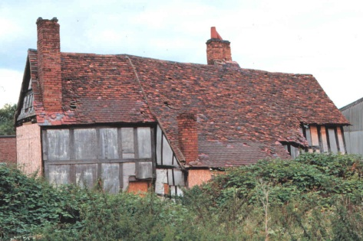
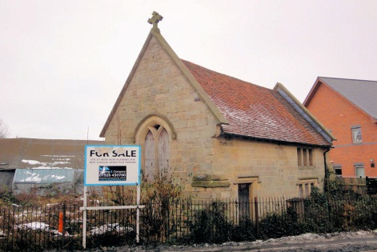
The brief is to develop a solution for the Leper Hospital site which provides a sustainable outcome around the three key parameters
St Michael’s Leper Hospital site contains the remains of St Michael’s Church and a 15th Century 2-storey timber framed building known as the Master’s House.
Both buildings are Grade II* listed Scheduled Ancient Monuments; the site is a Scheduled Ancient Monument.
Despite planning consents being obtained for office development, the site remains undeveloped and the buildings remain on the English Heritage At Risk Register.
The objective of the feasibility is to develop a sustainable solution for the future use of the site around three key parameters…
Conservation & Heritage
Sustainable Outcome
Community Benefit
Financial Optimisation
There is significant local interest and a wealth of knowledge regarding the site’s history which has been harnessed to inform the feasibility study
4

Slide 5
Consultation with a range of key stakeholders has provided background on the site and insight into the range of possible development opportunities
Who | Organisation | Role
Cllr Elizabeth Higgins | Warwick District Council Warwick Town Council | Heritage Champion Mayor
Nick Molyneux | English Heritage | Historic Buildings Inspector
Glynis Powell | Warwick County Council | Museum Development Officer
Judy Ross | Leamington Cons’n Trust | Chair
Lt. Col. Kenneth Cross | Order of Saint Lazarus | Commander
James Mackay | Warwick Society | Chairman
Dr Christine Hodgetts | Warwick Society | Historian
Laura Pye | Warwick County Council | Community Engagement Mgr
Caroline Stanford | Landmark Trust | Historian
Clive Haywood | Frank Haywood | Structural Engineer
Pattie Hall | Hill Close Gardens | Centre Manager
Jeff Watkin | Royal Pump Rooms | Heritage and Arts Manger
Louise Male | Action 21 | Manager
Tim Willis | Warwick County Council | Strategic Commissioning
Roy Mowbray | Waterloo Housing Group | Development Manager
Mark Patten | - | Owner’s son-in-law
Mark Thompson | Wareing & Co | Site Owner’s Agent
To gather background information on the history of the site and previous development schemes.
To understand the key development opportunities and constraints.
To capture insights into the local ‘market’ for the various use categories within Warwick.
To gauge stakeholders’ appetite for different change categories.
To explore the feasibility of specific development opportunities
The consultation process has been critical to identifying opportunities and generating stakeholder interest and engagement
The consultation process has allowed us to build up a clear picture of the site’s opportunities and constraints and these have been represented graphically…
5

Slide 6
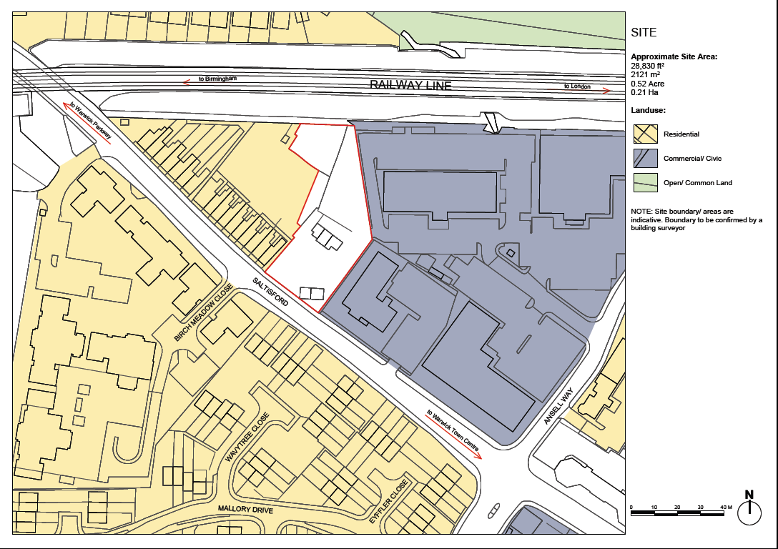
6

Slide 7
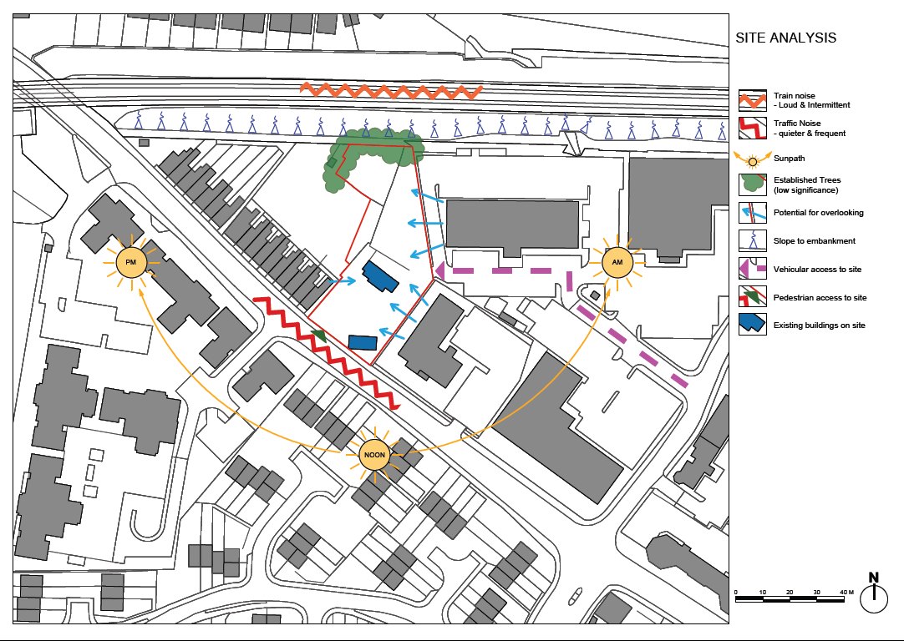
7

Slide 8
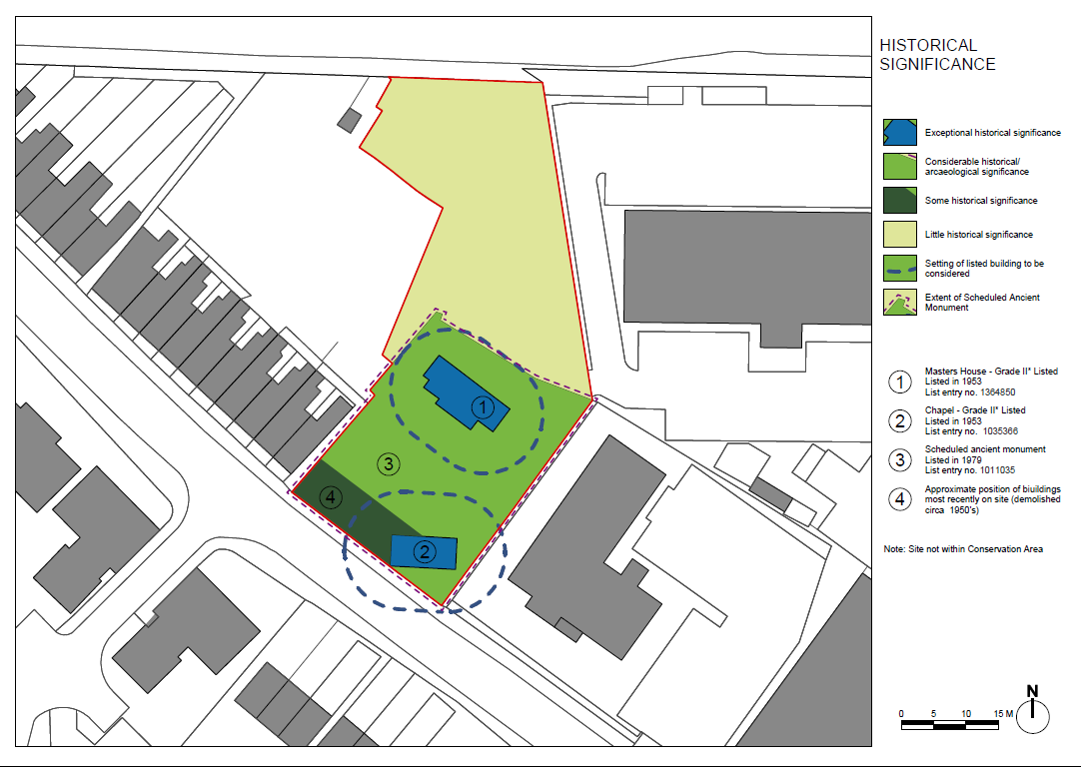
8

Slide 9
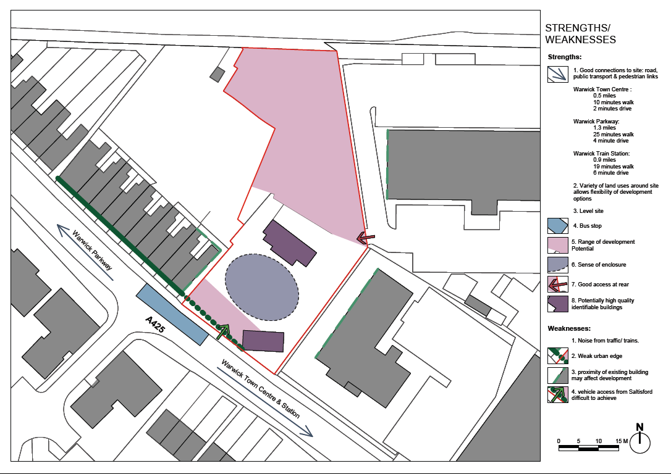
9

Slide 10
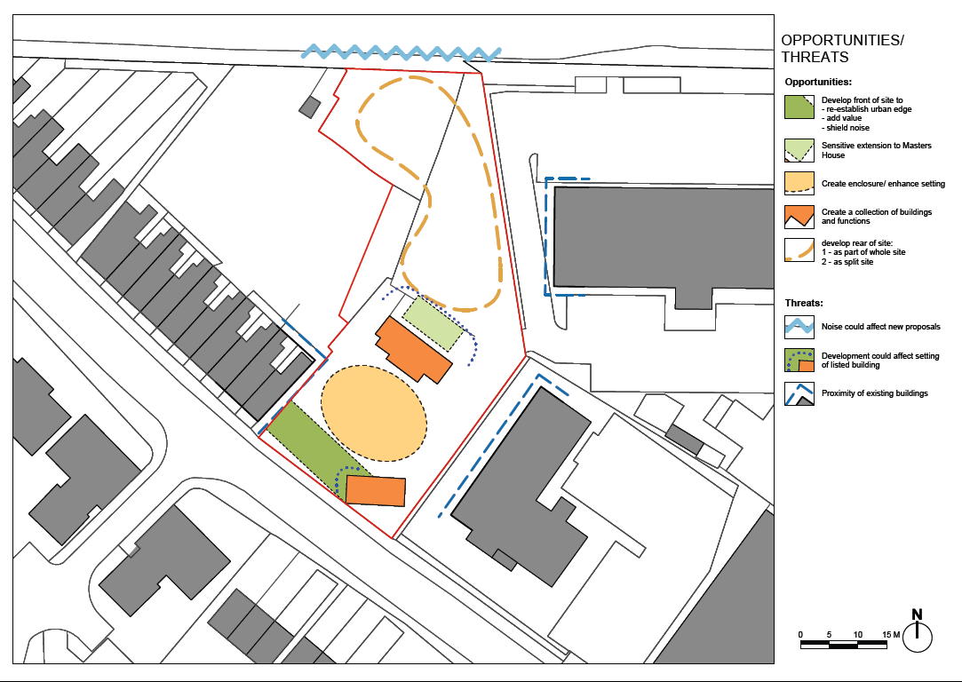
10

Slide 11
PART 2 – Options Assessment
  Assessment Criteria
  Options Evaluation
  Preferred Options Analysis
11

Slide 12

We have evaluated each option against specific criteria for each of the three assessment parameters identified
Assessment Criteria:
Contribution to Warwick’s Heritage / Cultural Offering
Successful interpretation of site’s narrative
Fulfilment of cultural needs in Warwick
Conservation & Heritage
Needs to be aligned with Warwick District Sustainable Communities Strategy
Sustainable Outcome
Capital Investment
£
Operational Subsidy
Community Benefit
Financial Optimisation
~ 5 years
Time
Assessment Criteria:
Ability to generate revex income
Revex requirement
Ability to generate capital income
Capital investment requirement
Assessment Criteria:
Safer Communities
Health & Wellbeing
Housing
Economy, Skills & Employment
This has allowed us to build up an overall assessment of how aligned each option is with WDC’s strategic objectives
12

Slide 13
This feasibility exercise has looked at a wide range of use categories and options for reconfiguring the site
RECONFIGURATION OPTIONS
USE CATEGORIES
Commercial Site Development
Residential
Split site into two and develop each part separately
Office
Retail
Heritage / Cultural Use
Gardens & Cafe
Keep buildings and develop the site as a whole unit
Museum
Current Site
Education Facility
Community Services
Social Housing
Assisted Living
Relocate buildings and develop the site as a whole unit
Day Centre
Allotments
Social Enterprise
Action 21
Business Incubator
Specialist End User
Landmark Trust
St Lazarus
Depending on how the site is reconfigured, the recommended solution may incorporate more than one use category
13

Slide 14
The strategic alignment score has been plotted against a viability assessment which considers the risk profile for each option
High
5
KEY
Commercial Site Development
No Sleep
No Brainer
4
Assisted
Living
Residential
F/H
Heritage / Cultural Use
Education
St Lazarus
Action 21
Allotments
Community Services
3
Gardens
& Cafe
Office
Business
Incubator
Social
Housing
Landmark
Trust
Social Enterprise
Strategic Alignment
Retail
Museum
Day Centre
No Point
2
No Way
Specialist End User
1
NOTE: The full options analysis breakdown is provided in the Detailed Option Appraisal Appendix
Low
1
2
Viability
3
4
5
High
The five options in the ‘No Brainer’ quartile have been taken forward as preferred options for further analysis

Slide 15

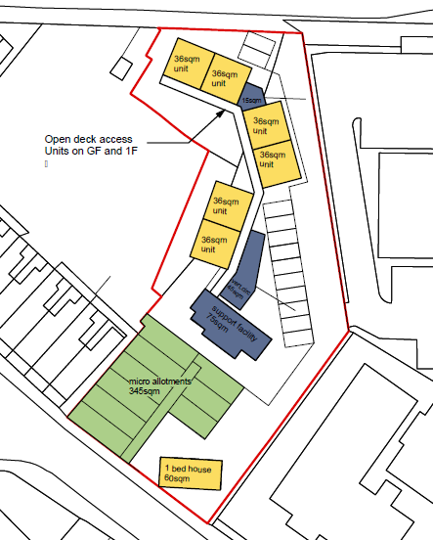
Supported Living / Specialist Residential Care
Description
Provision of up to 16 residential units for use by specialist provider of residential care, e.g. Dementia, Acquired Brain Injury, Mental Health support, etc. This option is viable with either the rear half of the site only, or to incorporate the whole site. If available, the front part of the site may be provided with raised bed allotments.
Benefits
Very well aligned with all WDC strategic objectives around community benefit including: safer communities, health & well-being, housing and employment. This option is flexible to future conversion into other residential use categories if necessary (subject to any necessary planning consents for change of use).
The existing buildings are suitable for adaptation into office / staff and communal accommodation facilities.
Under this option, assuming WDC does not wish to take the development risk, there is an opportunity to generate a one-off capital receipt, and the development risk would be taken by a developer / provider.
Our limited soft market testing has indicated that there is an active demand for such a facility. WCC are the main local commissioning body for care and are open to partnering in order to realise this solution.
CONCERNS
Branding of ‘Leper Hospital’ may need to be reconsidered to avoid stigmatising the care provision.
DESCRIPTION
BENEFITS
CONCERNS
*Note: This design is indicative only. Different providers may require alternative facilities or site configuration.
15

Slide 16

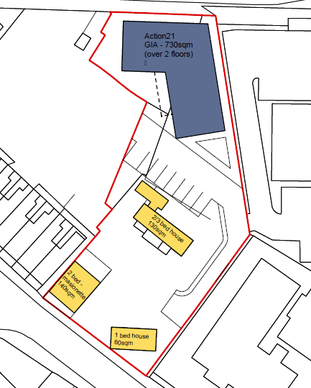
Action 21
Description
Action 21 is a volunteer-powered charity which runs projects that engage and inspire people to live more sustainably. Under this option, a 730m² light industrial unit is provided at the rear of the site as an off-shoot of the existing Re-Useful centre in Sydenham to sell donated second-hand goods including furniture, refurbished bicycles and tested electrical products.
Benefits
This option is well aligned with WDC’s strategic objectives around sustainable living, as well as providing some employment (est. 3-4 FTE’s).
Action 21 currently benefits from a lease at peppercorn rent on their facility in Sydenham which may be terminated at any time with 6-months’ notice. They are therefore keen to obtain security of tenure on a suitable premises.
CONCERNS
Although Action 21 do not require an operational subsidy, they would not be able to contribute to the capital cost of construction or contribute a rental income on a facility.
Should Action 21 cease to exist in future, it may be difficult to secure an alternative tenant for a light industrial unit in this location.
DESCRIPTION
BENEFITS
CONCERNS
Estimated Capital Costs (assumed enabling works complete)
£300k
16

Slide 17

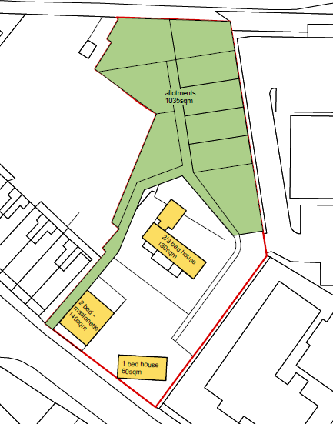
Allotments
Description
Provision of nine allotment plots across the rear of the site, including a possible pedestrian walkway leading from the main road.
Due to archaeological constraints, cultivation of the front half of the site would be restricted. However, it may be feasible to provide raised beds at the front which would allow those plots to be cultivated by people with impaired mobility.
Benefits
There is a large unmet demand for allotments within Warwick (current waiting list approx. 150), and this use is very well aligned with WDC’s strategic objectives around sustainable living. This option requires minimal capital investment and is essentially self-funding.
The tenure for the allotments may also be structured in order to allow the option of developing the plot for other options in future.
CONCERNS
Due to the site constraints, it is only possible to fit 9 micro-plots (half the standard size). It is assumed there would be no parking provision.
DESCRIPTION
BENEFITS
CONCERNS
Estimated Capital Costs (assumed enabling works complete)
£10k
17

Slide 18

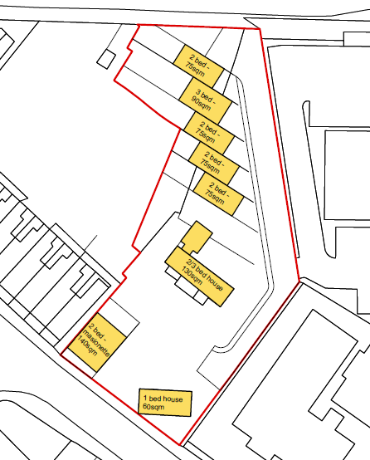
Residential – Private or Affordable
Description
Provision of up to nine residential units sale at either market rates or for affordable housing. The rear of the site may be developed to create five terraced house units (as shown opposite) or up to nine flats in a single block.
This option is viable with either the rear half of the site only, or to incorporate the whole site.
Benefits
Aligned with WDC strategic objectives around housing.
Generates maximum possible capital return for the site.
There is an opportunity to generate either a one-off capital receipt or on-going income, depending on the on tenure agreement negotiated with the provider.
CONCERNS
Overall alignment with WDC’s strategic objectives around cultural / heritage and community benefit is poor, and this may lead to low stakeholder acceptability. The financial return is also low, taken in relation to the cost and risks associated with the enabling package.
DESCRIPTION
BENEFITS
CONCERNS
Estimated Capital Receipts (assumed enabling works complete)
Tenure | Masters House | Chapel | Front | Rear (Terrace) | Rear (Block)
Private | £46k | Not viable | £56k | £176k | £135k
Afford | Not viable | Not viable | Not viable | £8k | Not viable
18

Slide 19

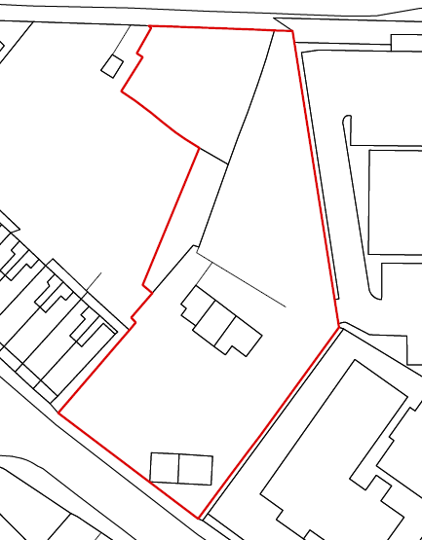
Order of St Lazarus of Jerusalem
Description
The Order of St Lazarus of Jerusalem have indicated that they may wish to acquire the front half of the site and to convert the Master’s House into an office (incorporating a heritage / educational facility), and to return the chapel into a chapel. In addition, they may wish to provide a conference / banqueting facility at the rear of the site.
The Order is open to a partnership arrangement with WDC (or other 3rd party) who wish to use those parts of the site which they have no use for.
The Order currently appears to be at an early stage of deciding the potential viability of acquiring and developing the site for these purposes.
Benefits
Good alignment with strategic objectives around contributing to Warwick’s cultural offering. Shared burden for meeting costs of site acquisition and / or enabling package to prepare the site and restore existing buildings prior to development.
CONCERNS
The Order may require any partner organisation to provide them with an income in order to meet the on-going operational and maintenance costs.
Should the Order of St Lazarus chose to provide a conference / banqueting facility at the rear of the site, there are currently no viable partnership options which could fit with this use.
DESCRIPTION
Conference / banqueting facility (Option)
Office and Cultural / Heritage Facility
BENEFITS
CONCERNS
Chapel
19

Slide 20
PART 3 – Recommended Solution
  Enabling Works
  Soft Market Testing Insights
  Delivery Options
  Conceptual Design
  Development Risk Analysis & Mitigation Steps
  Funding Options
20

Slide 21
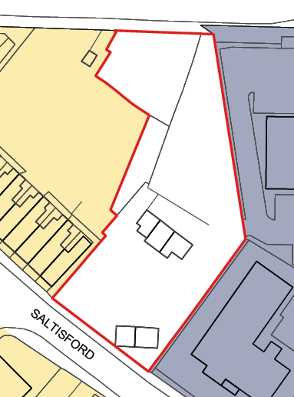
Prior to proceeding with any solution, an enabling contract is required to prepare the site and restore existing buildings at an estimated cost of approximately £1m
SITE WORKS:
Clearance & levelling
Boundary fencing
Upgrade to highway / site entrance
£76k*
MASTERS HOUSE:
Temporary works
Underpinning / foundation support
Structural repairs to timber frame
Masonry repairs
Window & door replacement
Re-roofing
Damp treatment
£620k*
UTILITIES:
Incoming electrical / water / gas
Foul drainage
£62k*
CHAPEL:
Temporary works
Repairs to structural frame
Repairs to vaulted roof
Masonry repairs
Provision of ground floor
Windows & doors
Damp treatment
£210k*
TOTAL
£968k
*Note: Subtotals include Prelims (20%), OH&P (5%), Contingency (10%) and Fees (12%)
Enabling works will need to be completed on the existing buildings before any other parts of the site can be developed
21

Slide 22










Supported Living provides the best ‘fit’ with WDC’s strategic objectives and further soft market testing has been carried out to confirm the viability of this option
The market testing exercise has confirmed that demand exists from this sector, and provided some valuable insights into the market for assisted living accommodation
The site is only suitable for specialist care providers with a small number of residents
Usually, the market is demand-driven rather than site-driven; the site must be de-risked in order to attract developer / providers.
As the public body which commissions care, it is essential that Warwick County Council are closely associated with the scheme in order to minimise the development risk.
It is not possible at this stage to meaningfully assess the land value for the site after the enabling works have been completed.
However, site constraints mean that the land value may be significantly lower than the cost of completing the enabling package.
It is recommended that prior to proceeding with this option, a full market report is commissioned to understand the nature of local demand
22

Slide 23
Our market testing has shown that there are essentially two options to take this solution to the market, depending on WDC’s appetite for development risk
Description | Advantages | Disadvantages | Risk
OPTION 1: WDC to develop the site themselves to provide care accommodation, which would be leased to a Provider on a short-lease basis (typically up to 7 years with a 3 year break clause). | Higher income revenue generated. Possibility to convert the facilities into residential use in future if necessary. | WDC would be taking on development risk and could potentially end up with a liability if the site became vacant in future. The higher risk on this option may also make it harder to access funding from EH.
OPTION 2: To go to market with a development agreement for a Developer / Provider to take a long lease to develop the site. | Provides long-term solution. No exposure to development risk or on-going operational & maintenance costs. | Lower income generated.
HIGH
LOW
We understand that option 2 is more aligned with WDC’s risk appetite and this decision shapes the implementation programme
23

Slide 24
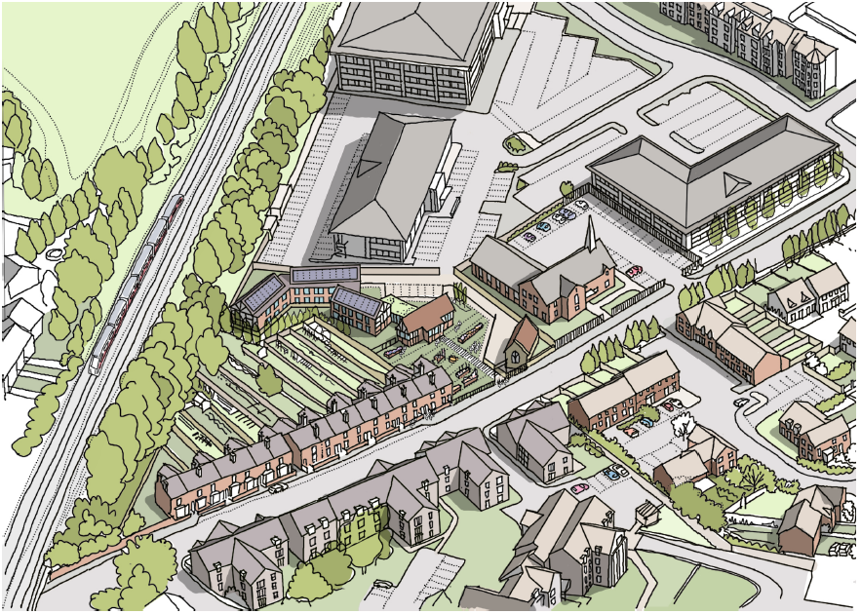

Whilst the design for an Assisted Living solution will be dependent on the care provider’s requirements, we have developed a high level conceptual design
The scheme visualisation above may be useful to demonstrate the development possibilities with both developers and stakeholders
24

Slide 25
In order to secure interest from the developer / provider market, it will be necessary to mitigate the development risks in four key areas
Planning Risk
Design Risk
Existing
Buildings Liability
Commercial Risk
  Development Brief
  A comprehensive Development Brief should include an outline of the type of development expected or encouraged by local planning policies.
  Supplementary Planning Document (SPD)
  The Development Brief can be issued as an SPD which will be taken into material consideration when determining an application for full planning permission.
  Outline Consent
  Outline consent may also be obtained for providing additional accommodation at the rear of the site.
  Development Brief
  The Development Brief should inform developers of the parameters within which the site can be developed, clearly setting out the design constraints and opportunities presented by a site.
  Enabling Works
  Following completion of structural and condition surveys of the existing buildings, a full outline specification should be prepared for the enabling works. This should be included within the Development Brief with a commitment that the works will be completed subject to execution of the Development Agreement.
  R&M Obligations
  Obligations for the future maintenance & repair of the existing buildings should be clearly stated within the Development Brief.
  WCC Partnering
  In order to minimise the commercial risk, it is recommended to partner with Warwick County Council who are the main care commissioning body. WCC have indicated they are open to providing a letter of support and potentially a minimum care contract tied to the development agreement.
In mitigating the development risks, WDC can play an ‘enabling’ role to support the successful realisation of the recommended solution
25

Slide 26


An English Heritage repair grant offers the best opportunity for contributing towards the cost of carrying out enabling works
Funding Body | Relevant Key Funding Criteria | Application Risk | Recommended Approach
(For Site Purchase) | Purchase grants available where: • it will reduce risk to building preservation; • price reflects the condition & value; • adequate plans for management & m’tce; • significance to heritage are demonstrable. | Owner may wish to | Market price at current condition & value is minimal. Purchase grant not recommended
(Repair Grant For Enabling works) | National EH funding priorities include ‘significant elements of the historic environment at risk’. Priority is given to ‘Redundant buildings at risk that have the potential to be brought back into active use and to contribute to key local strategies’. | Masters House is on the EH At Risk register and a priority for grant aid. | Recommend repair grant application made for restoration of the Masters House (concurrently with marketing of a Development Agreement). Match funding from other bodies will significantly reduce application risk.
 | To receive a grant your project must: • help people to learn about their own and other people’s heritage. Your project must also do either or both of the following: • conserve the UK’s diverse heritage for present and future generations to experience and enjoy; • help more people, and a wider range of people, to take an active part in and make decisions about heritage. | Assisted Living use poorly aligned with primary EH objective around learning due to lack of public access. Order of St Lazarus may be able to access funds. | HLF application not recommended HLF funding may be available for the Order of St Lazarus if they chose to proceed with the scheme.
MODERATE
LOW
HIGH
HLF funding will require public access to the site and would therefore only be available for St Lazarus
26

Slide 27


Further funding may be available from other bodies such as the King Henry VIII Trust although these will be more limited in value
Funding Body | Relevant Key Funding Criteria | Application Risk | Recommended Approach
Enabling Grant | The Trust can make grants for the following purposes if for the benefit of the inhabitants of the Town: a) Repair of historic buildings. b) Relief of the elderly, infirm and needy. c) Improvement of social welfare and leisure. d) For the support of educational facilities. No powers to make grants for projects for which local government has a financial responsibility | Grant application assessment appears to be highly subjective. Unclear how application would be considered. Maximum grant likely to be c.£30k | Recommend application made for discrete and visible element of the enabling work to restore Masters House at value of approx £50k. (e.g. windows & doors).
AHF Project Development Grant | For costs and expenses of developing a project once its viability has been established Grant for building preservation trusts (i.e. admin costs & fees) The building(s) must be listed, scheduled as an ancient monument. The project must involve a change of ownership and/or a change of use. | Maximum grant is £20k | Not recommended due to relatively low grant value in relation to complexity of required freehold transfer to Leamington Conservation Trust in order to access this funding.
AHF Low Interest Loan | Short-term, low-interest loans for acquisition and/or working capital to repair historic buildings. | Ceiling of £500,000 with interest charged at 5% | Not recommended for reasons as stated above, plus interest level charged is not competitive in current market.
MODERATE
LOW
LOW
27

Slide 28
PART 4 – Implementation
  Outline Implementation Programme
  Purchase Contingency Plans
28

Slide 29
It is recommended that Supported Living market research report is commissioned whilst St Lazarus consider their decision on whether to proceed
TIME
Funding
Obtain EH letter of comfort for funding
Submit English Heritage / AHF funding application
Draw down of WDC funds / EH Grant
Handover to Developer / Provider
Purchase site from current owner
EH Funding Grant obtained
Draw down of necessary funds for site purchase
WDC to pass resolution committing funds subject to DA and EH funding
Draw down HLF / Other Funds
Carry out Enabling Works
Submit HLF / Other Funding Application
Procure enabling works package
St Lazarus
Develop outline design and costings
Development Agreement signed
St Lazarus
Go / No-Go Decision
Enabling Works
Develop detailed cost estimate for enabling works
Obtain outline planning permission
TIME
Obtain minimum care contract commitment from WCC
Issue Dev’t Agreement to market
Issue Development Brief as Supplementary Planning Document
Develop Business Plan
Carry out full structural & condition survey of existing buildings
Define outline scope of Enabling Works
Development Agreement
Appoint accredited Conservation Architect & professional team
Prepare Conservation Management Plan
Prepare Development Brief
Define repair & maintenance obligations
Review funding options
Commission local market report for Assisted Living
KEY
St Lazarus
WDC
Owner subject to St Lazarus Go/No-Go Decision
29

Slide 30
The wide discrepancy between the Market Valuation of the site and the current owner’s expectation represents a major delivery risk
In a Market Value Report dated 15 Dec 2011, DVS valued the site at £25k.
DVS note that “The cost of refurbishment of the buildings far outweighs the value of the site... and it could be argued that the site has a negative value”
The stated asking price by Wareing & Co, the agent acting for the landlord is £550k
In order to address this issue, English Heritage have indicated their willingness to support statutory action:
Enforcement notices (in escalating order)
      Section 215 Notice: Where it is considered that the condition of a piece of land adversely affects the amenity of the area in question. The notice will require steps to be taken which the local planning authority considers will remedy the problem.
      Urgent Works Notice: requiring repair works to be carried out to prevent further decay. The notice will specify the works, which are considered reasonably necessary for the preservation of the building. An Urgent Works Notice is restricted to emergency repairs only
      Repairs Notice: A Repairs Notice is not restricted to urgent works and may include works to preserve architectural details but can not be used to restore lost features.
      Compulsory Purchase Orders: If building not repaired within 2 months, the Planning Authority can serve a CPO.
The enforcement route could potentially take several years to complete and a negotiated solution is strongly recommended
30

Slide 31
Appendix – Detailed Option Appraisal
31

Slide 32
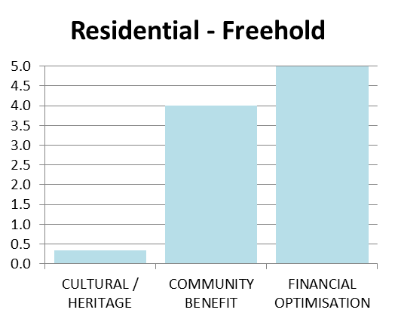
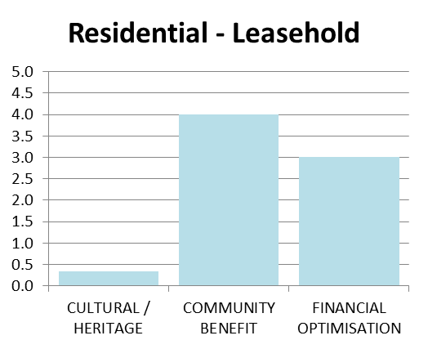
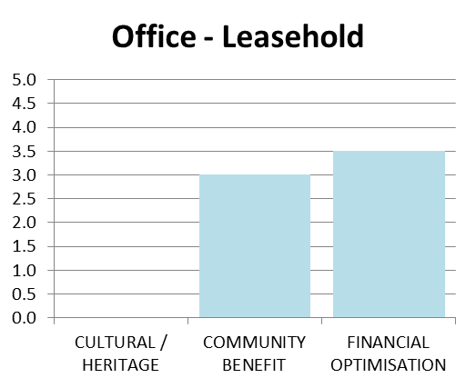

We have carried out a high level assessment of certain option groups – ie Commercial Site Development…
Residential - Freehold
Residential - Leasehold
Office - Leasehold
Retail - Leasehold
Development of areas of the site into residential units for freehold sale including possible conversion of the existing buildings.
Development of areas of the site into residential units for leasehold rental including possible conversion of the existing buildings.
Development of rear half of the site for new build office accommodation, including possible conversion of existing buildings.
Development of rear half of the site to provide retail units, including possible conversion of existing buildings.
Feasibility 3.8
Feasibility 3.5
Feasibility 1.0
Feasibility 1.0
Advantages: Demand exists for market residential accommodation EH open to development along road frontage Planning precedent exists at rear | Disadvantages: Potentially low stakeholder acceptability Development risk
Advantages: Rental demand exists for market residential accommodation | Disadvantages: Potentially low stakeholder acceptability Higher initial capital investment requirement Revenue risk
Advantages: EH open to development at road front Planning precedent exists at rear | Disadvantages: Site has been unsuccessfully marketed for office use for a decade; Limited parking availability. Development risk
Advantages: EH open to development at road front Would only require limited area. | Disadvantages: Very limited demand for retail space in the area; would require niche tenant. Development risk Limited parking availability.
Strategic Alignment 3.1
Strategic Alignment 2.4
Strategic Alignment 2.2
Strategic Alignment 2.2
Advantages: Meets strategic goals around housing provision Generates capital return English Heritage open to additional development along line of existing terraces | Disadvantages: No long-term revenue stream generated
Advantages: Meets strategic goals around housing provision Generates on-going revenue stream English Heritage open to additional development along line of existing terraces | Disadvantages: High capital investment required; no immediate capital return.
Advantages: Some alignment with strategic goals around economy, skills & employment Generates on-going revenue stream English Heritage open to additional development along line of existing terraces | Disadvantages: Moderate alignment to strategic goals.
Advantages: Some alignment with strategic goals around economy, skills & employment Generates on-going revenue stream English Heritage open to additional development along line of existing terraces | Disadvantages: Moderate overall alignment with WDC strategic goals
32

Slide 33
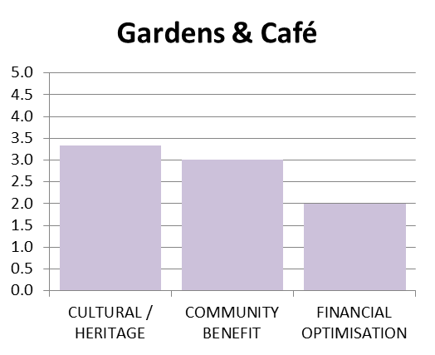
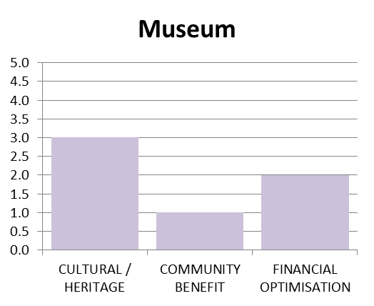
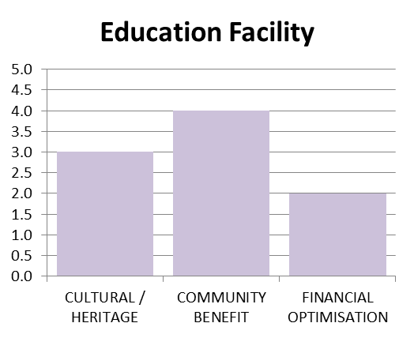
… Heritage / Cultural Use
Gardens & Café
Museum
Cultural Education Facility
Creation of civic amenity space including gardens, and conversion of one of the existing buildings into cafe.
Conversion of one or both existing buildings into museum space.
Conversion of one or both existing buildings into education facility in conjunction with museum / other heritage use.
Feasibility 0.0
Feasibility 0.0
Feasibility 0.0
Advantages: High stakeholder acceptability | Disadvantages: Other similar facilities already exist locally. No apparent public demand for such a facility
Advantages: High stakeholder acceptability | Disadvantages: No existing display collection Number of other museums already exist locally. No public demand
Advantages: High stakeholder acceptability | Disadvantages: Other heritage education facilities already exist locally. No apparent public demand
Strategic Alignment 2.8
Strategic Alignment 2.0
Strategic Alignment 3.0
Advantages: Good alignment with strategic goals around community benefit and cultural heritage. | Disadvantages: Option will require continued public subsidy to meet operational and maintenance costs.
Advantages: Good alignment with strategic goals around cultural / heritage use. | Disadvantages: Option will require continued public subsidy to meet operational and maintenance costs.
Advantages: Strong alignment with strategic goals around community benefit and cultural use. | Disadvantages: Option will require continued public subsidy to meet operational and maintenance costs.
33

Slide 34
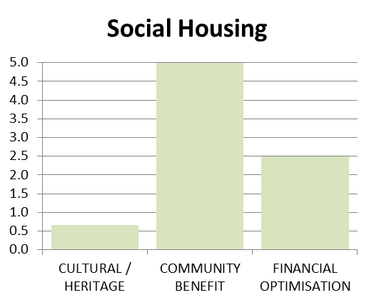
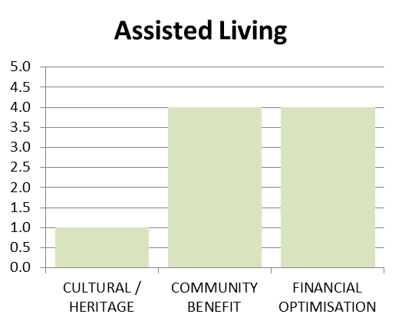
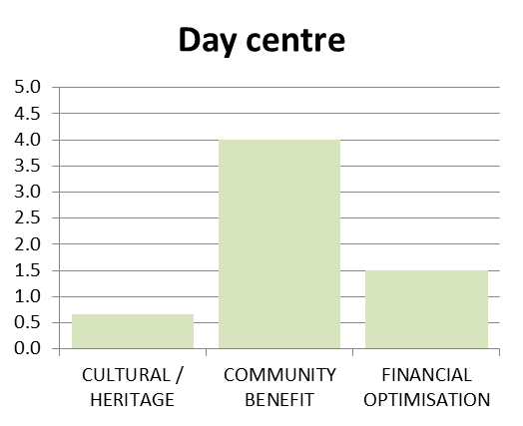
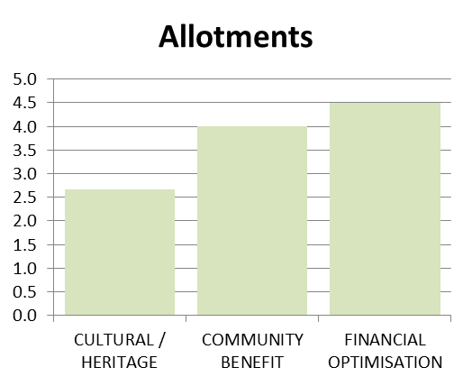
… Community Services
Social Housing
Assisted Living
Day Centre
Allotments
Development of areas of the site into residential units for social housing including possible conversion of the existing buildings.
Development of areas of the site into assisted living units including possible conversion of the existing buildings.
Development of areas of the site into Community Day Centre including possible conversion of the existing buildings.
Use of external areas as allotments, likely to be in northern part of site behind the Master’s House.
Feasibility 2.0
Feasibility 4.0
Feasibility 1.0
Feasibility 3.5
Advantages: Demand exists for Social Housing Low funding risk | Disadvantages: Financial benefit is limited Limited current interest from social housing providers
Advantages: Stakeholder acceptability Limited capital investment requirement Providers are interested | Disadvantages: Financial return may be significantly less than capital investment from enabling works
Advantages: Strong stakeholder acceptability | Disadvantages: No potential user yet identified
Advantages: High stakeholder acceptability Strong local demand (circa 150 on waiting list currently) | Disadvantages: Archaeological restrictions may prevent cultivation of southern half of site.
Strategic Alignment 2.7
Strategic Alignment 3.0
Strategic Alignment 2.1
Strategic Alignment 3.7
Advantages: Planning precedent exists for new-build development at rear of site. Strong alignment with strategic objectives around provision of housing Self-funding. | Disadvantages: No revex income generation Weak alignment to cultural / heritage objectives.
Advantages: Planning precedent exists for new-build development at rear of site. Strong alignment with strategic goals around safer communities and housing | Disadvantages: No revex income generation. Weak alignment to cultural / heritage objectives.
Advantages: Planning precedent exists for new-build development at rear of site. Strong alignment with strategic objectives around safer communities. | Disadvantages: No revex income generation. Weak alignment to cultural / heritage objectives.
Advantages: Consistent with historic use of land around hospital site for cultivation. Meets existing local need. Strong alignment with strategic objectives around Health & Wellbeing and Economy Skills & Employment Self-funding | Disadvantages: Limited site area means few plots could be created. No capital or revex income generated.
34

Slide 35
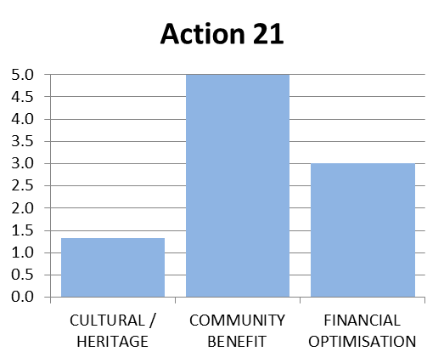
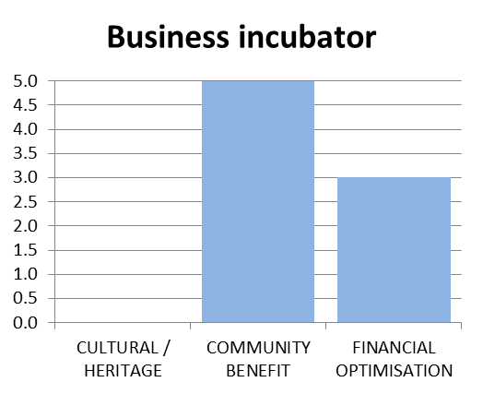
… Social Enterprise
Action 21
Business Incubator
Partnership with Action 21, a local charity supporting sustainable living.
Development of the site into commercial units targeted at small start-up businesses.
Feasibility 3.0
Feasibility 0.0
Advantages: High stakeholder acceptability Self-funding (long-term) Action 21 are actively interested | Disadvantages: Subject to Action 21 commitment.
Advantages: Good stakeholder acceptability Funding availability | Disadvantages: Size of development area insufficient to support a viable scheme.
Strategic Alignment 3.1
Strategic Alignment 2.7
Advantages: Strong alignment with strategic objectives around Health & Wellbeing and Economy Skills & Employment No long-term requirement for operational funding | Disadvantages: No capital or revex income generated.
Advantages: Planning precedent exists for new-build development Strong alignment with strategic goals around Economy, Skills & Employment Generates on-going revenue stream | Disadvantages: Poor alignment to most strategic goals.
35

Slide 36
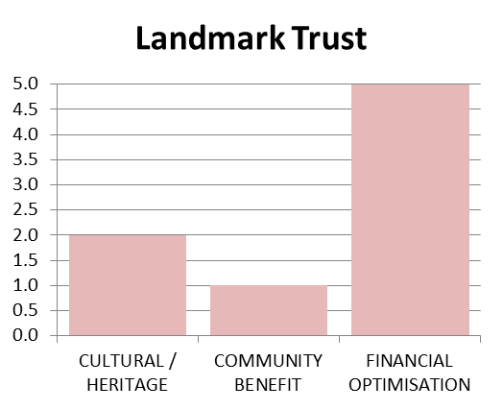
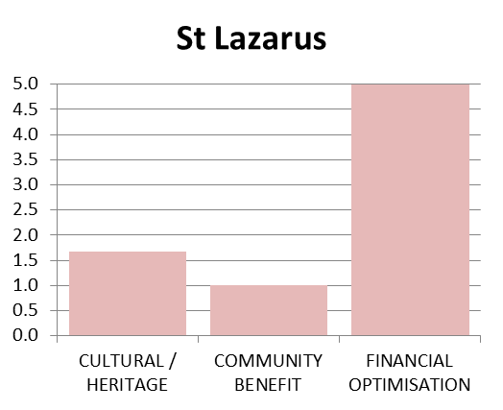
… Specialist End User
Landmark Trust
St Lazarus
Development of existing buildings into holiday lets through the Landmark Trust.
Purchase and use of the site by Order of St Lazarus of Jersusalem
Feasibility 0.0
Feasibility 4.0
Advantages: Generates secure income stream to support site long-term. Good stakeholder acceptability | Disadvantages: Site Constraints of noise & location mean that this is not a viable option.
Advantages: No financial risk to WDC Good stakeholder acceptability St Lazarus actively interested | Disadvantages: None
Strategic Alignment 2.7
Strategic Alignment 2.8
Advantages: Contributes to need in Warwick for additional quality visitor accommodation Rental income provides financial security | Disadvantages: Minimal community benefit
Advantages: Opens opportunities for partnership with WDC to provide community benefit. Very successful interpretation of the site’s narrative. Financial security | Disadvantages: Minimal community benefit.
36

Slide 37
Appendix – Strategic Alignment and Viability Assessment Matrix
37

Slide 38
Summary Strategic Alignment and Feasibility Matrix
38

Slide 39
Appendix – Full Feasibility Assessment Outline Plans
39

Slide 40
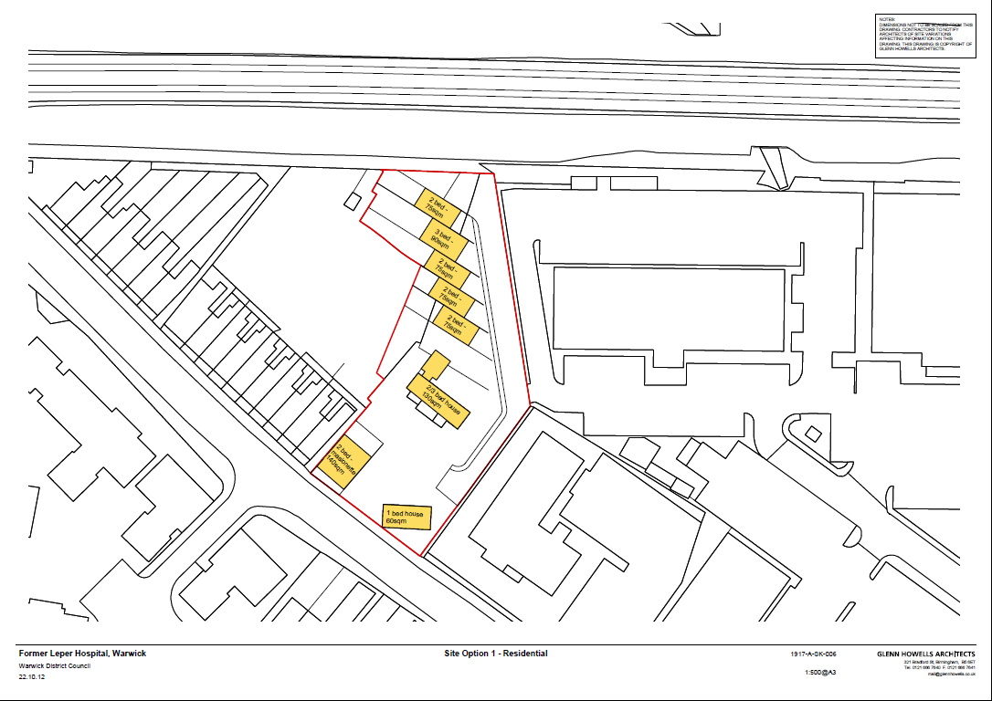

Slide 41
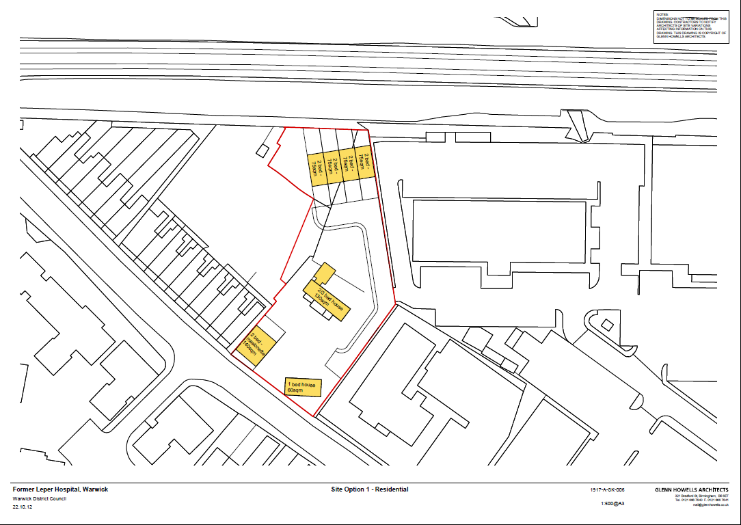

Slide 42
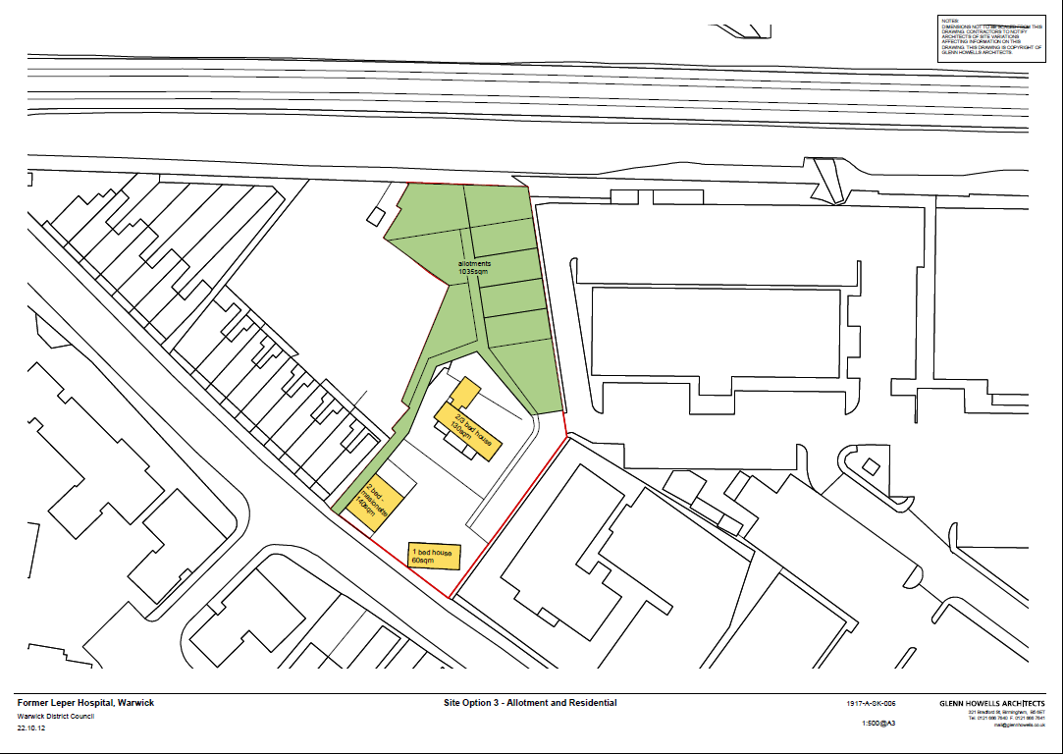

Slide 43
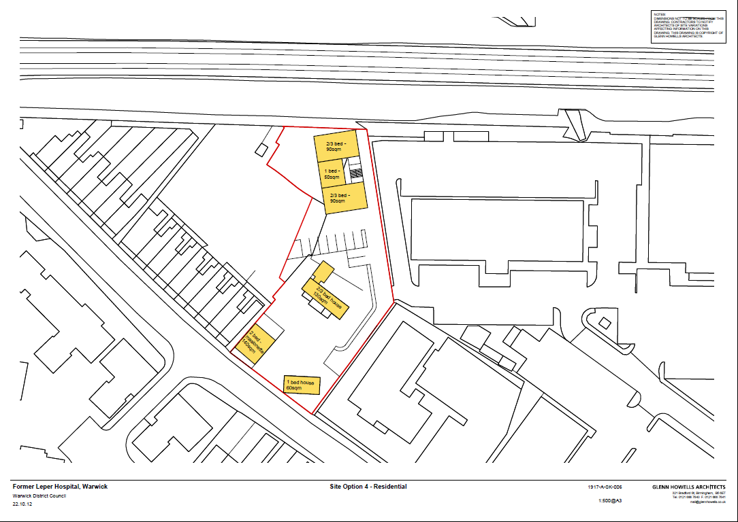

Slide 44
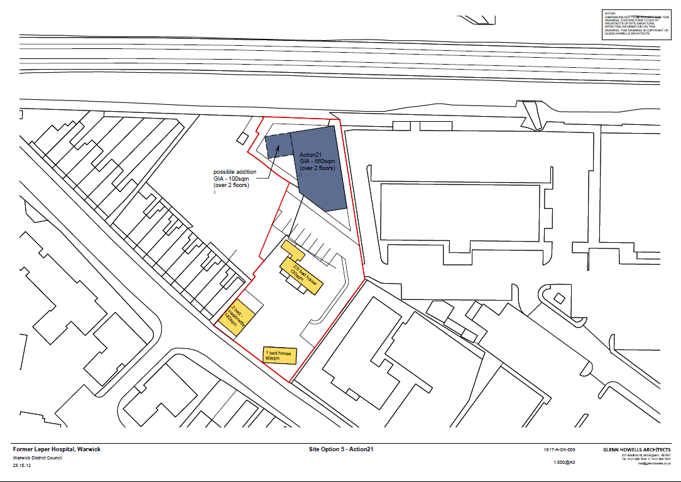

Slide 45
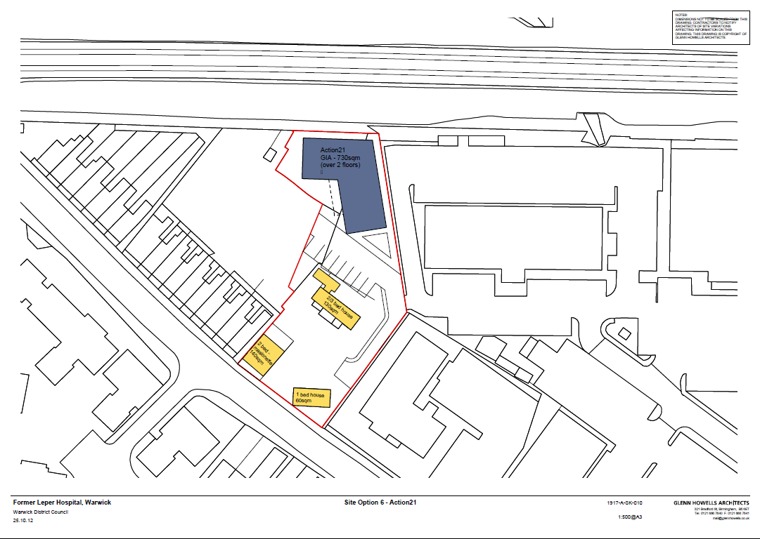

Slide 46
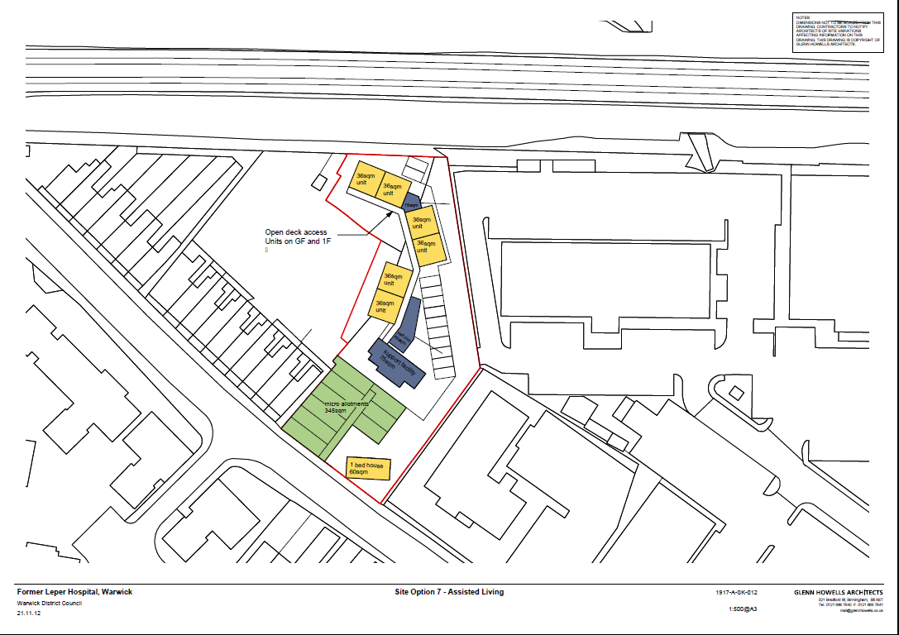

Slide 47
