Slide 1
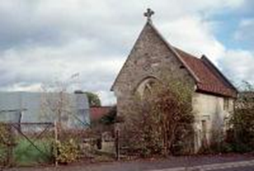
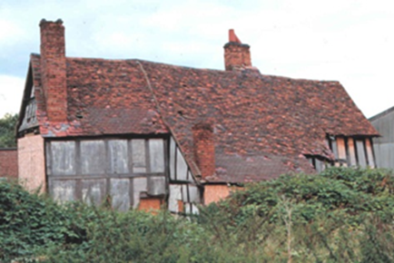
St Michael’s Chapel and Master’s House, Saltisford Warwick
Exciting Partnership Development Opportunity

Slide 2
Introduction
Welcome
Introductions:
Tim Willis, Strategic Lead (Care and Choice Accommodation) programme, Warwickshire County Council
Andy Jones, Deputy Chief Executive, Warwick District Council
Alan Mayes, Warwick District Council, Principal Architect Planner
Shape of today
Short presentation
Question and answer session

Slide 3
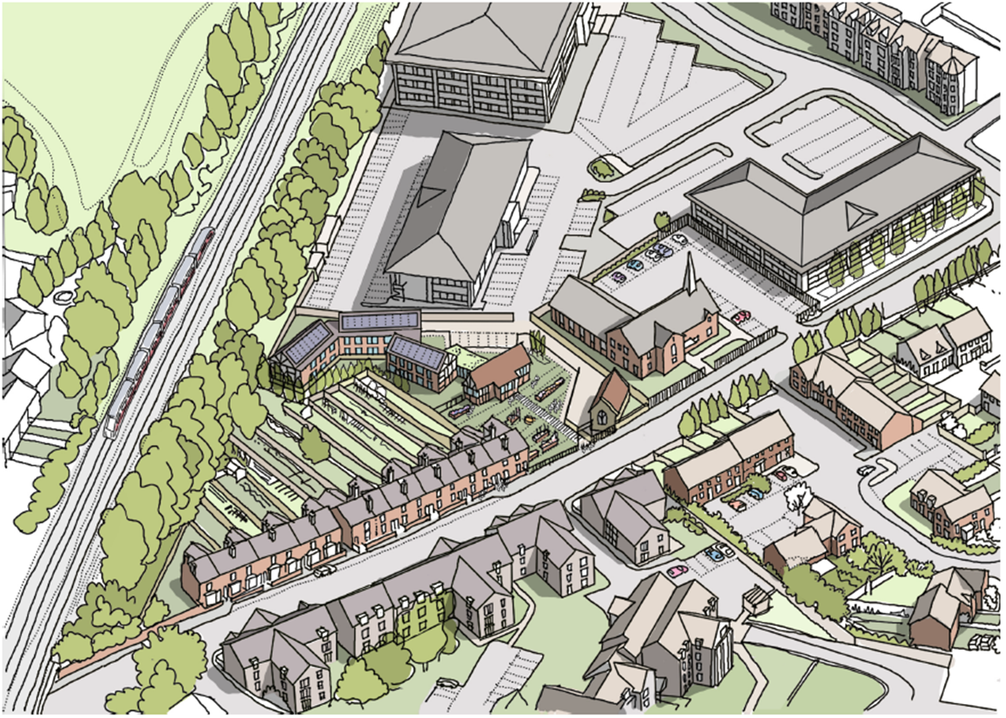
What we are seeking to achieve
Identify a sustainable solution for the site
Realise conservation and community benefits

Slide 4
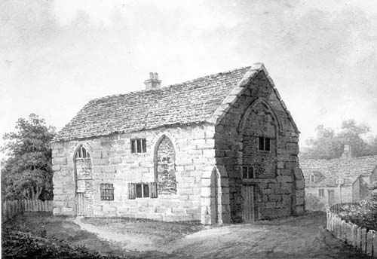
The story so far
Desire to restore listed buildings and recognition of potential for the site
Archaeological Evaluation 2004
Planning consent for development of site approved 2007
Scheduled Monument Consent granted 2009
Feasibility study commissioned 2012
Engagement with English Heritage and Homes and Communities Agency
Market testing

Slide 5
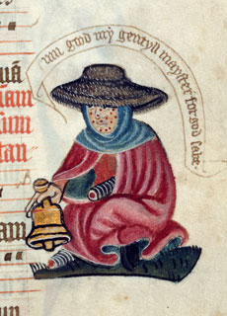
A piece of history
At least 320 religious houses and hospitals for care of lepers (known as leper or “lazar” houses) established in England (between end of c11th and 1350
This site is one of three known examples of leper hospitals in country
Leper hospital – provide permanent segregation rather than medical care
A leper begging for alms from the margins of an English Pontifical c1425 - British Library

Slide 6
History - continued
Below ground remains of leper hospital, chapel and cemetery – scheduled ancient monument
Current standing buildings, Chapel - single cell stone-building of 15th century date and Master’s House - timber framed late 15th to early 16th Century
Hospital founded by Roger, Earl of Warwick in 1135
First reference to leper hospital in 1275 and by 1540 it was said to be “much in ruin”
1545 – leased to layman Richard Fisher, distributed alms
1557 – last priest recorded as warden takes office
Chapel and Master’s House converted to cottages 17th-18th centuries

Slide 7
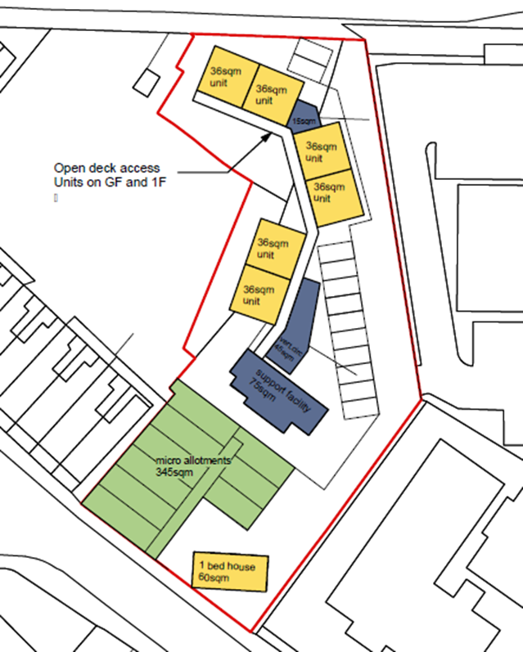
Site delivery and information
Specialist accommodation to meet mental health needs
Feasibility study indicates potential to deliver 10 – 16 mixed tenure units
Develop in line with WDC guidelines, DoH Extra Care Toolkit, 10 HAPPI principles
Open to market ideas
Indicative design to indicate site potential

Slide 8
Conservation considerations Alan Mayes, WDC Principal Architect
Part of the site is a Scheduled Ancient Monument and may require an additional Scheduled Monument Consent
The Master’s House and Chapel are grade II* listed. Consent has been granted for restoration of the Master’s House . Further listed building consent will be required for alterations to these buildings
Specialist contactors will be required for works to these buildings
English Heritage will need to be consulted about the proposals

Slide 9
Care Delivery
Growing need for Housing with Care
Growing demand for Specialised Housing
Suitable for people experiencing dementia
Introduction of “ EOP Locksmith” model
Unlock potential for individual well-being

Slide 10
Housing with Care update
161 units now in place
399 units under construction
Planning consent in place for further 311 units
Further applications imminent
Growth of private funding market
More sites for Specialised HwC to follow

Slide 11
Enabling Works
Rough order of magnitude assessment assesses enabling works required at approx. £1m

Slide 12
Next steps
Continue discussions with interested parties to identify sustainable solution
Apply for English Heritage Funding
Bidding process
Work up Development Agreement
Commence work

Slide 13
Question and answer session
Your questions

